Slide 1
Colaboración INMEGEN, metatranscriptoma NASH
19.08.2022

Slide 2
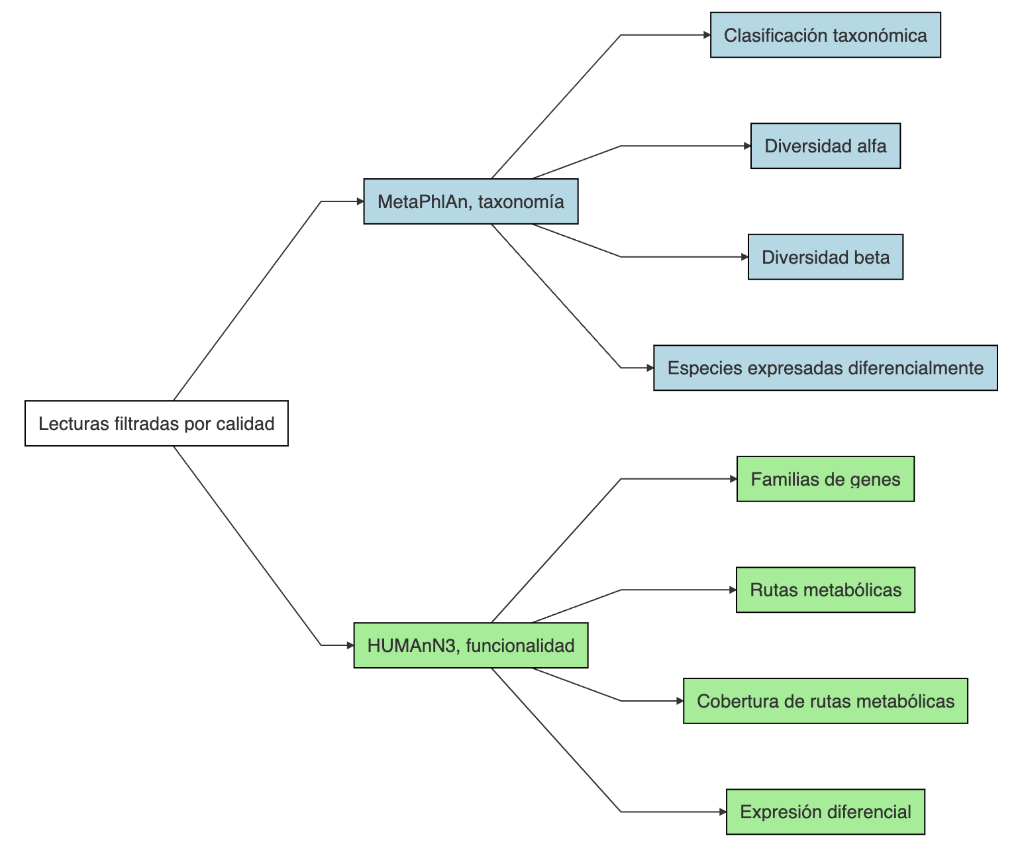
Pipeline

Slide 3
Metadata final
sample | Sex | Status_1
RL509-mf | Female | NASH
RL511-mf | Female | NASH
RL514-mf | Female | Control
RL516-mf | Female | Control
RL518-mf | Male | NASH
RL528-mf | Female | NASH
RL568-mf | Female | NASH
RL569-mf | Female | Control
RL573-mf | Female | Control
RL585-mf | Male | Control
RL591-mf | Female | NASH
RL601-mf | Male | NASH
RL605-mf | Female | NASH
RL606-mf | Male | NASH
RL607-mf | Female | Control
RL610-mf | Female | Control
RL613-mf | Female | NASH
RL616-mf | Female | NASH
RL627-mf | Female | Control
RL628-mf | Female | Control
RL641-mf | Male | NASH
RL651-mf | Female | Control
RL654-mf | Male | Control
RL656-mf | Female | NASH
RL659-mf | Female | NASH
RL663-mf | Male | NASH
RL665-mf | Female | NASH
RL667-mf | Female | NASH
RL668-mf | Female | NASH
RL679-mf | Female | NASH
RL680-mf | Female | Control
RL682-mf | Male | Control
RL683-mf | Female | NASH
RL686-mf | Male | Control
RL691-mf | Female | Control
RL693-mf | Female | Control
RL700-mf | Male | Control
RL703-mf | Female | Control
RL704-mf | Female | Control
RL725-mf | Female | Control

Slide 4
Comparaciones
NASH vs Control considerando todas las muestras
NASH vs Control estratificando por género (Male)
NASH vs Control estratificando por género (Female)

Slide 5
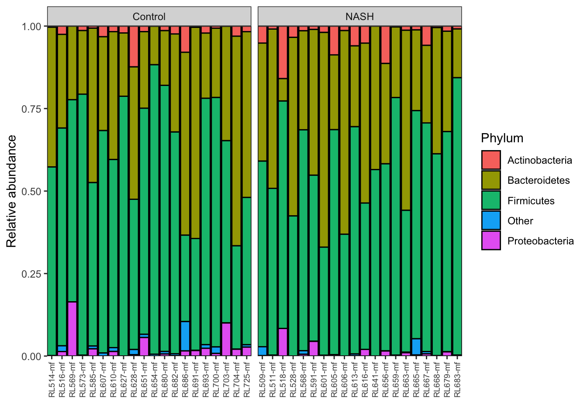
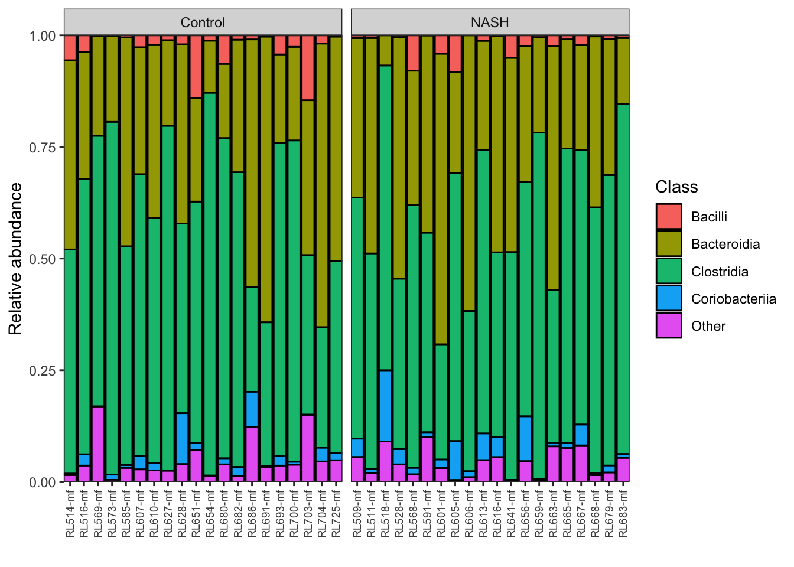
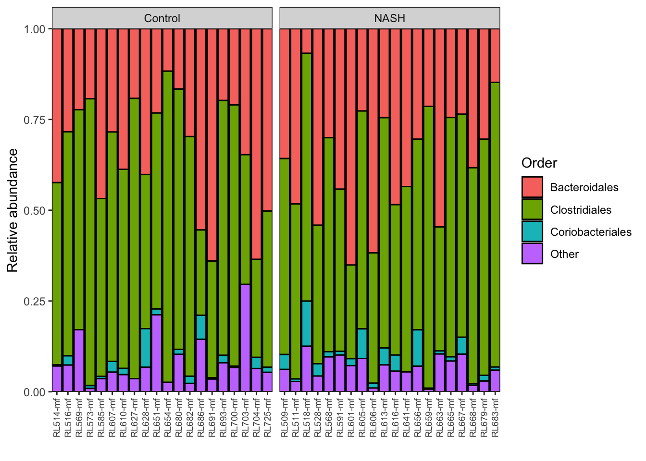
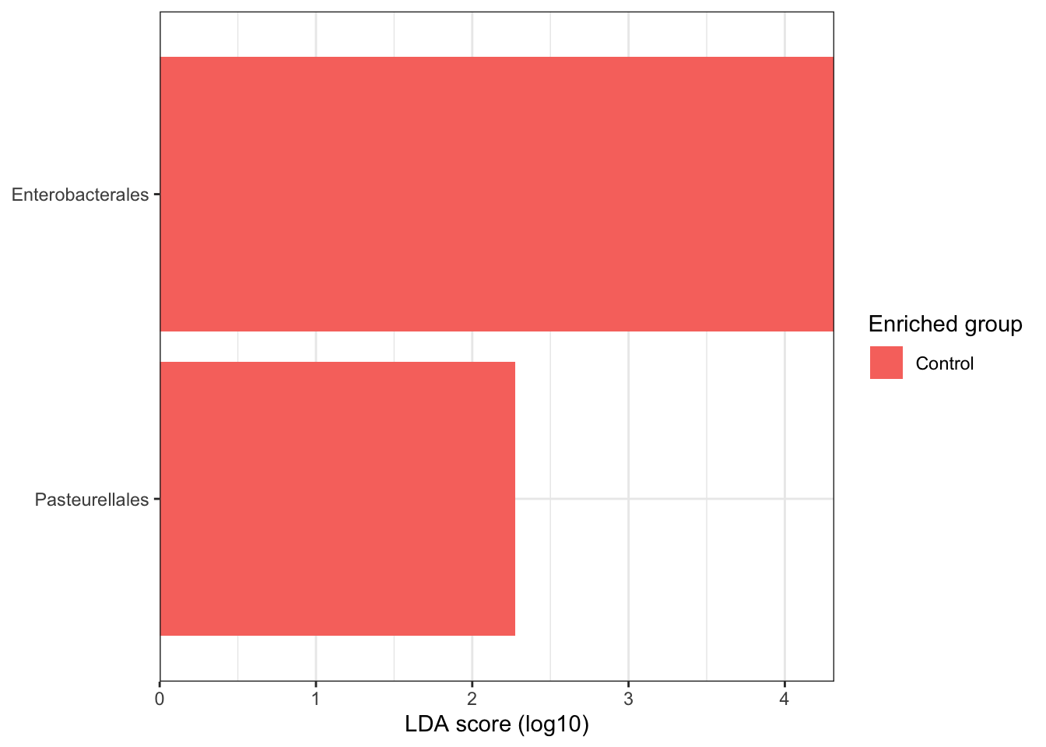
NASH vs Control considerando todas las muestras

Slide 6
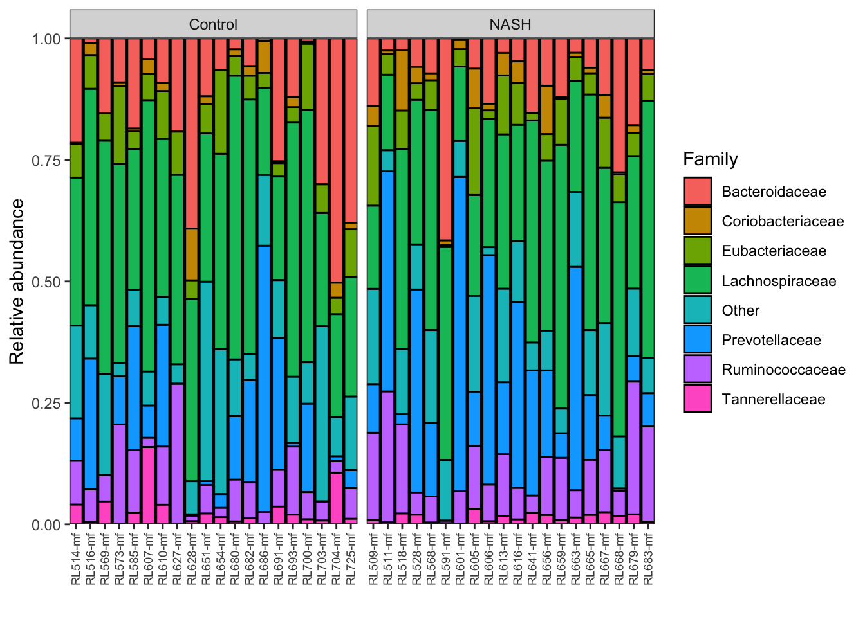
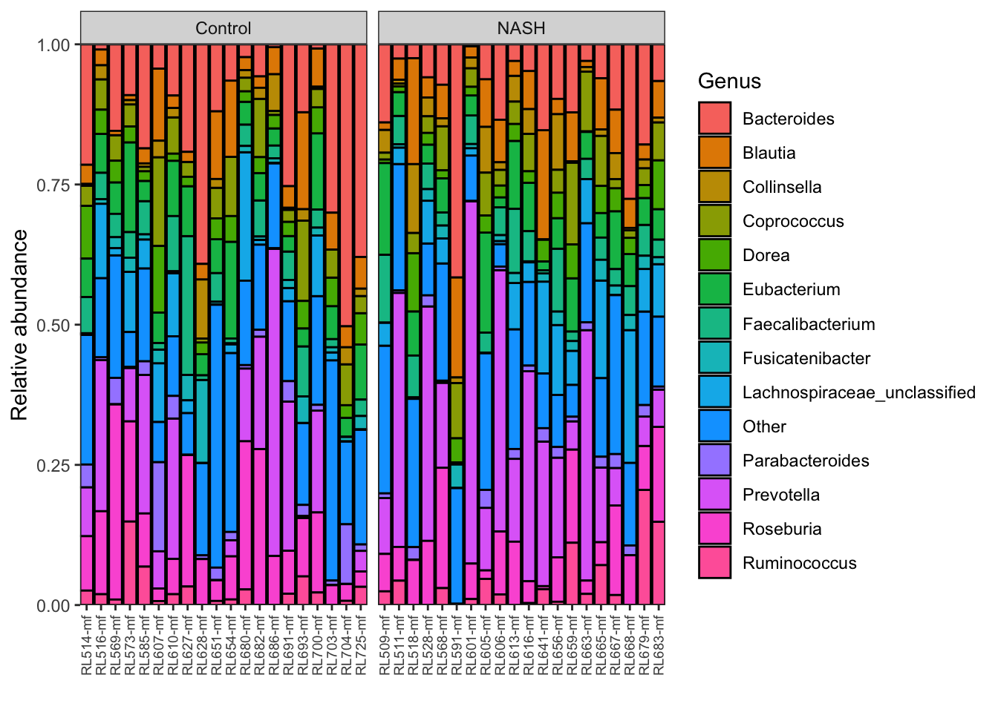
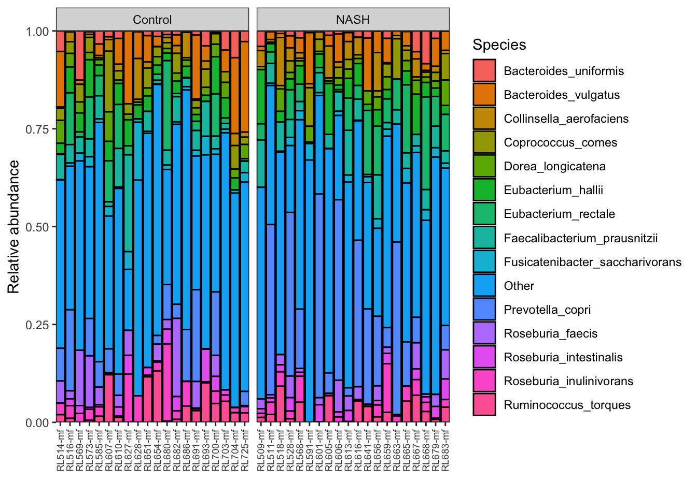
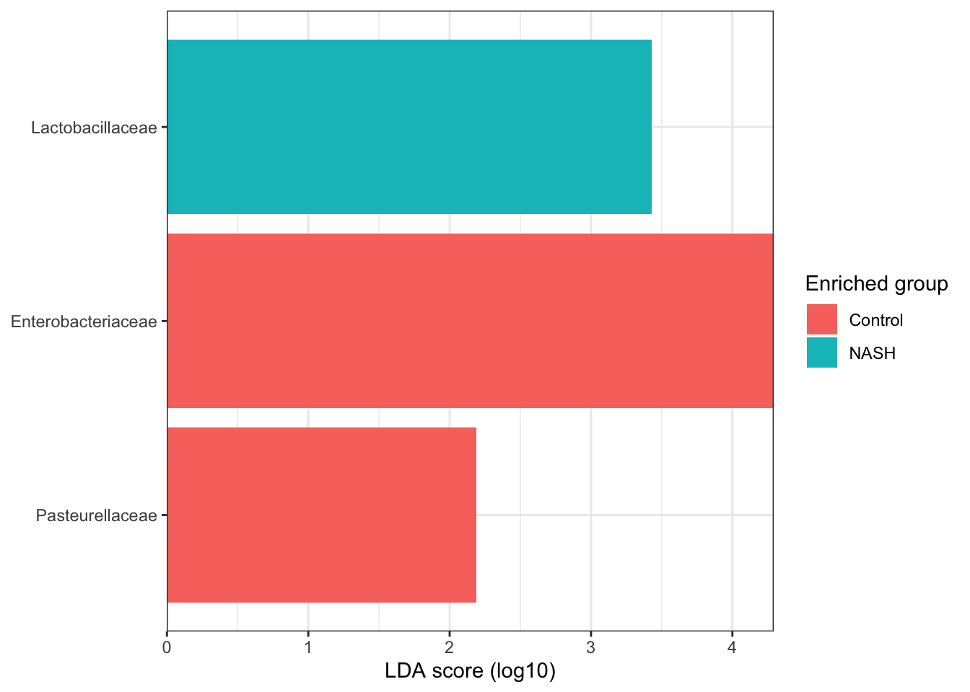
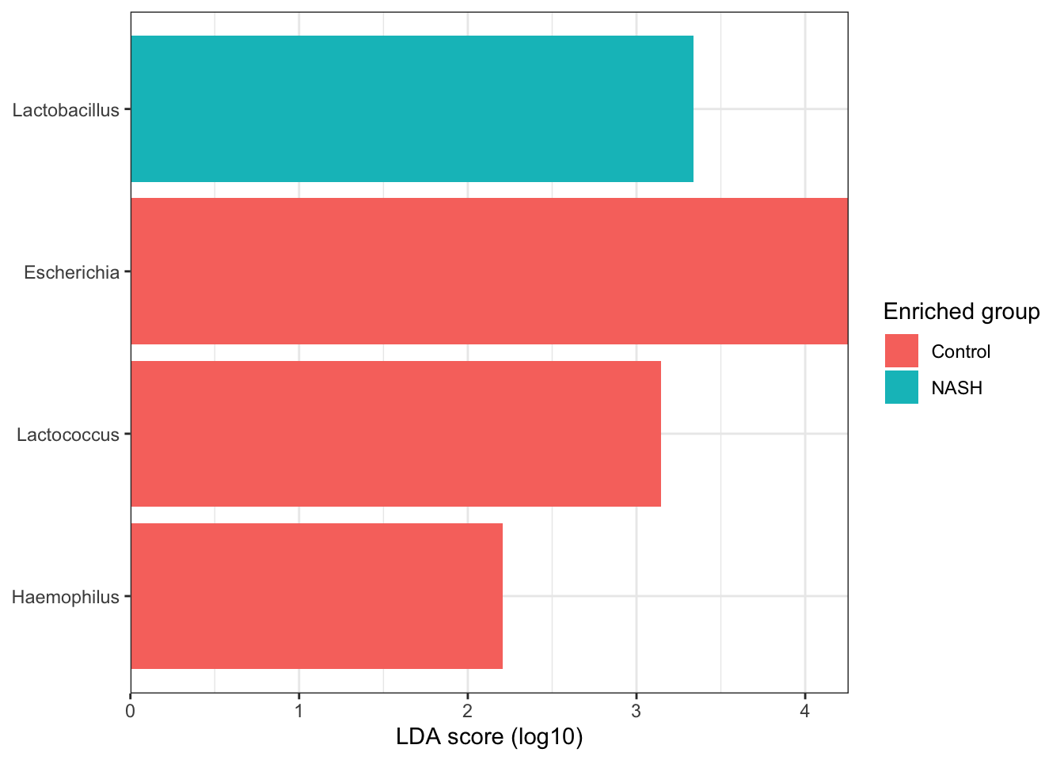
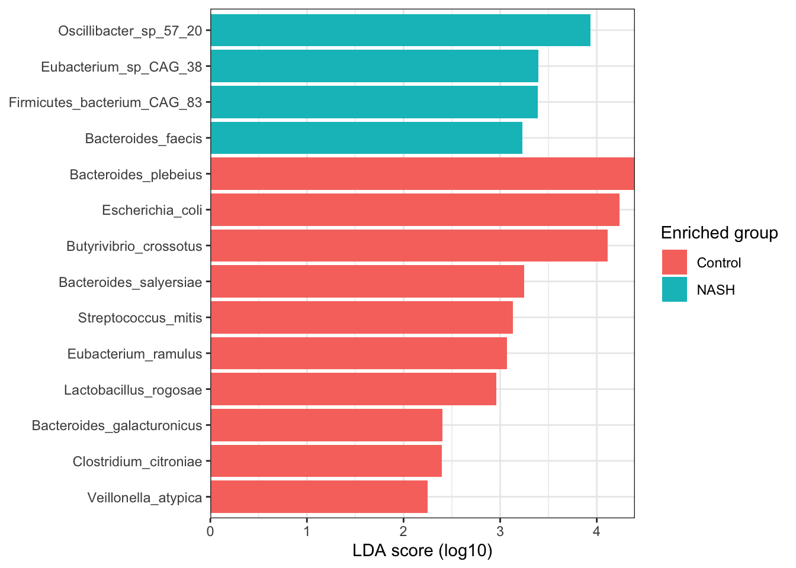
NASH vs Control considerando todas las muestras

Slide 7
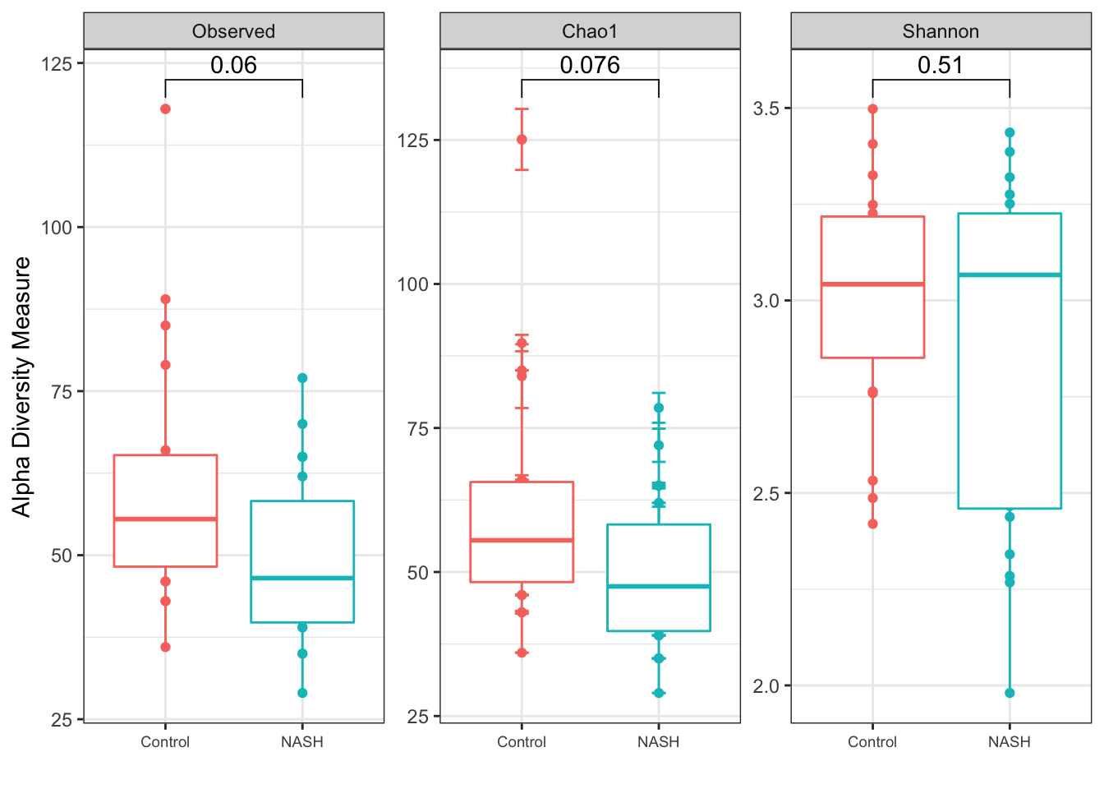
NASH vs Control considerando todas las muestras

Slide 8
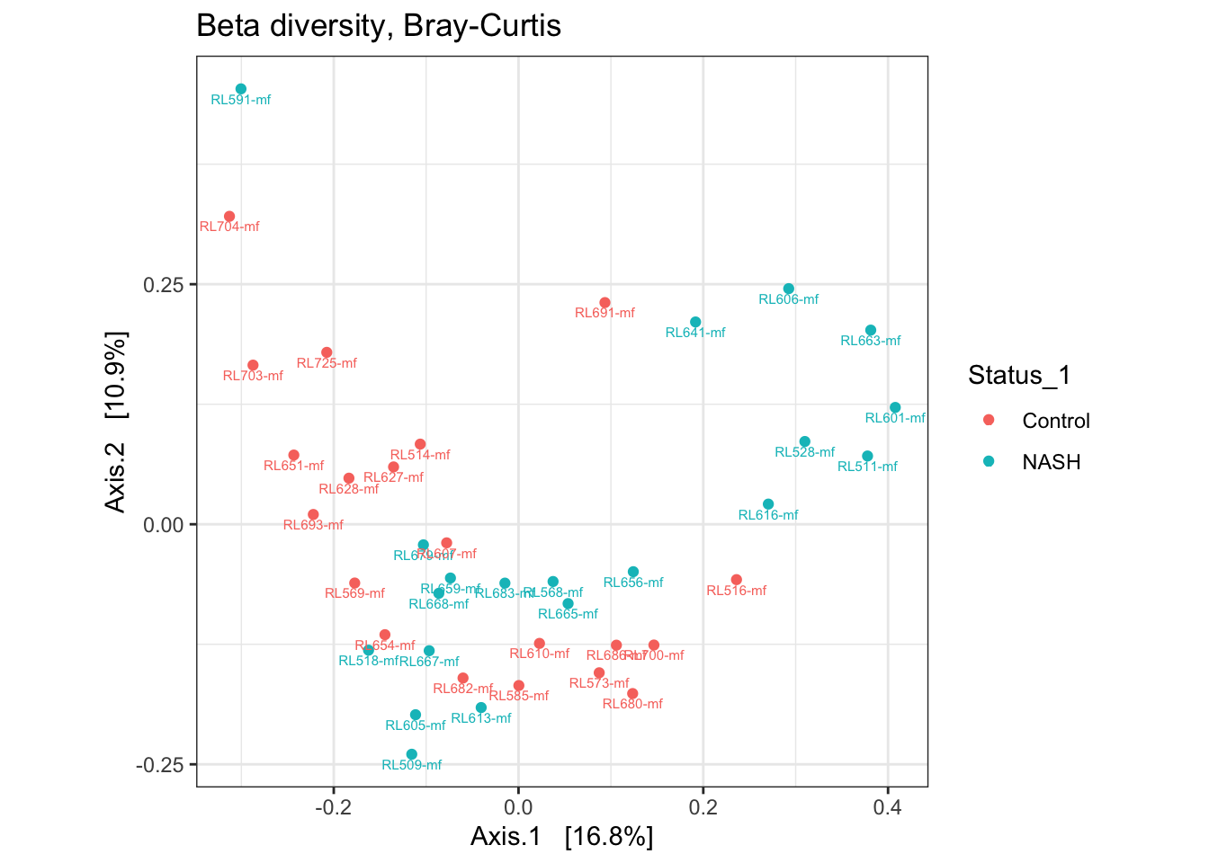
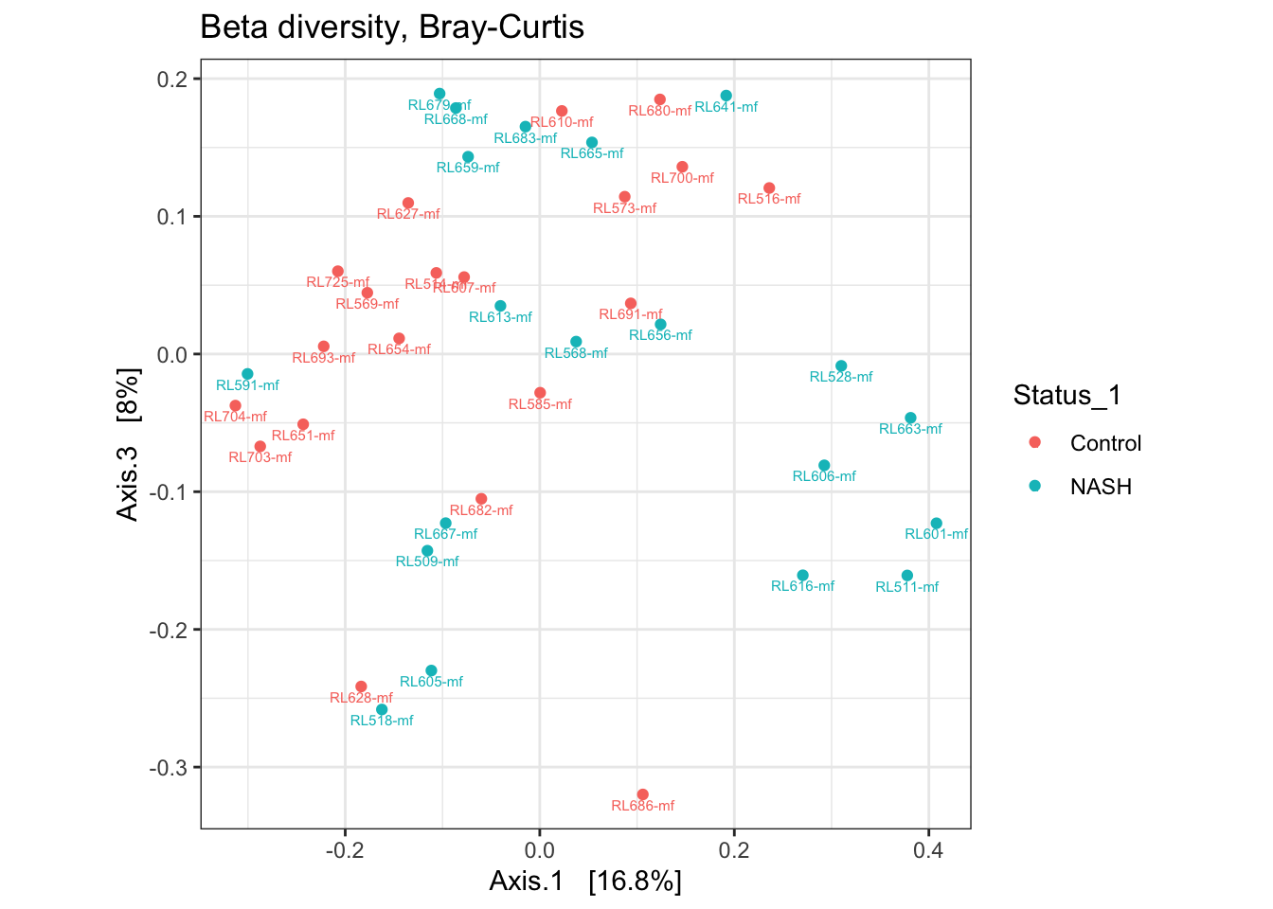
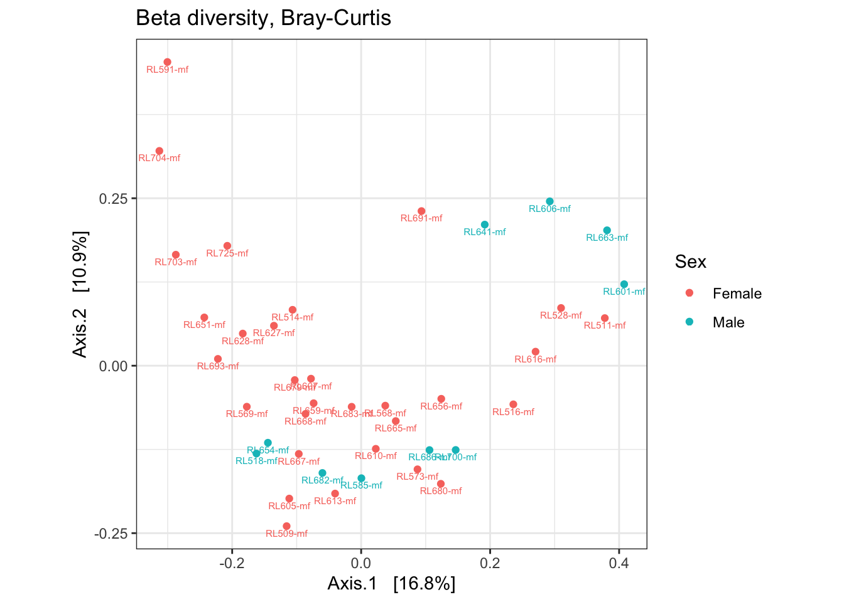
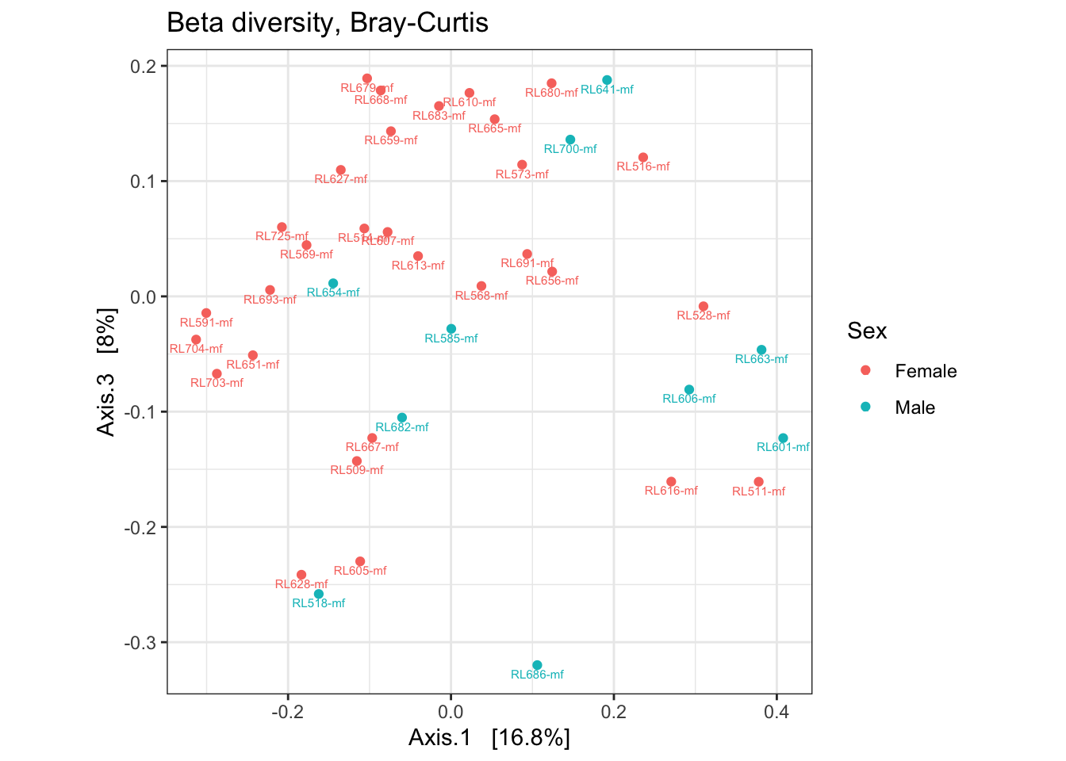
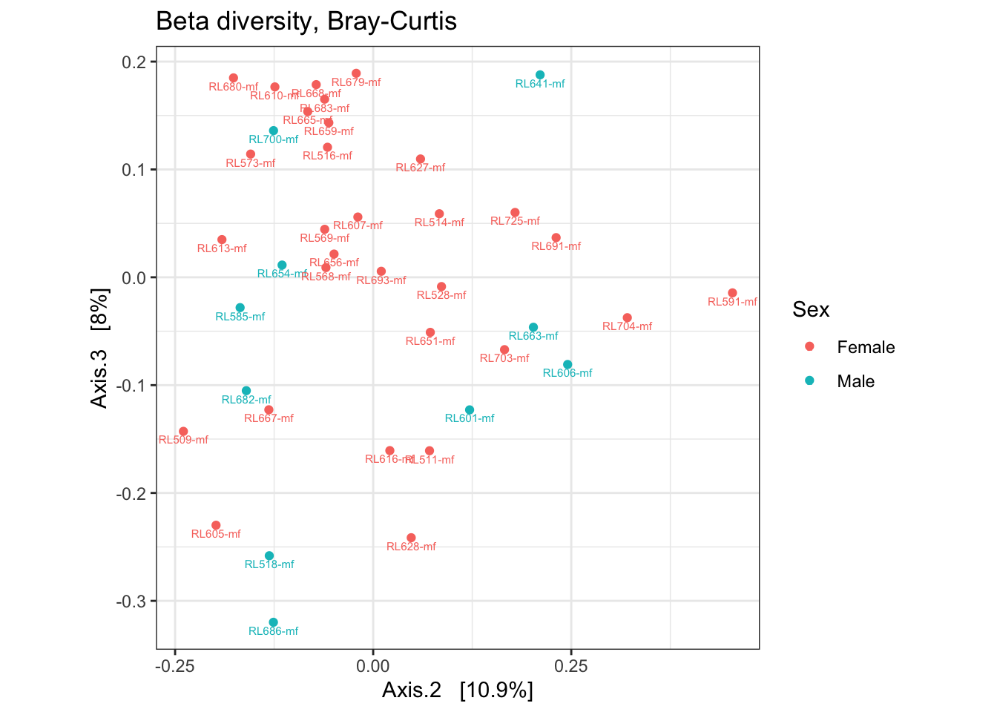
NASH vs Control considerando todas las muestras, Bray Curtis

Slide 9
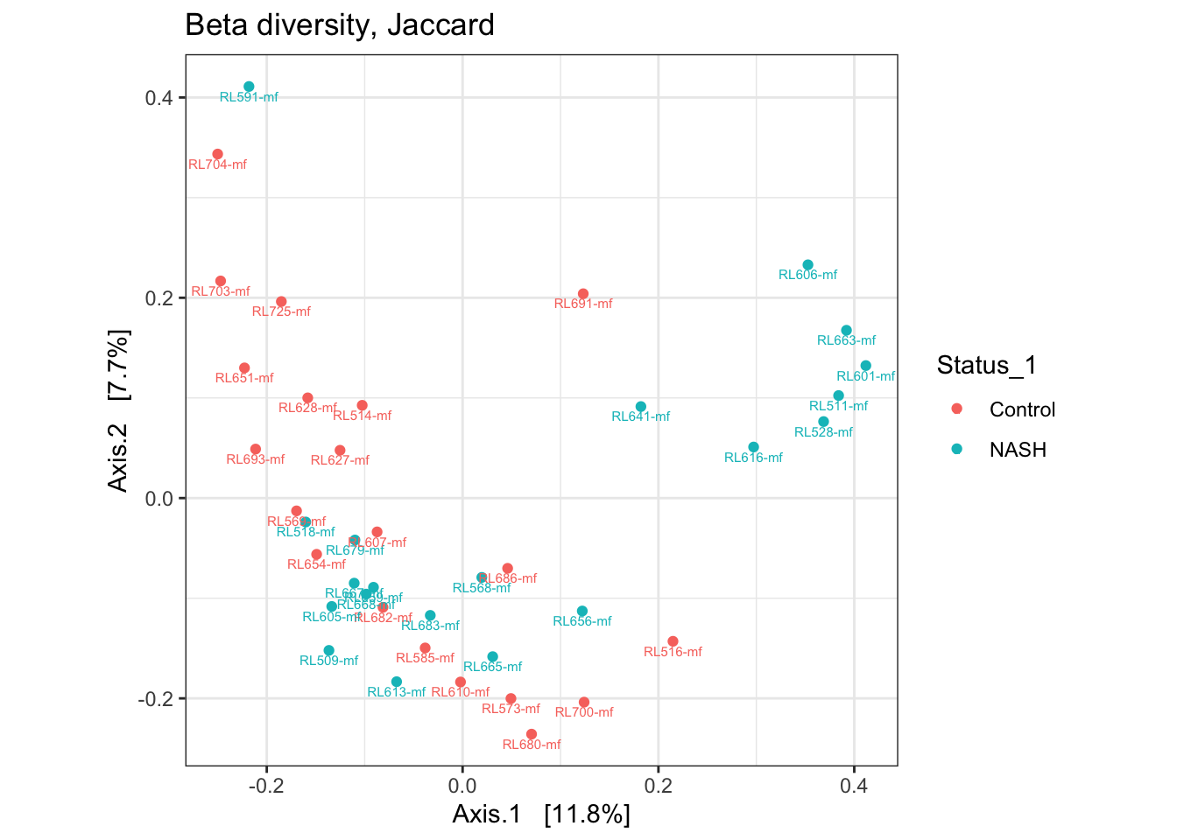
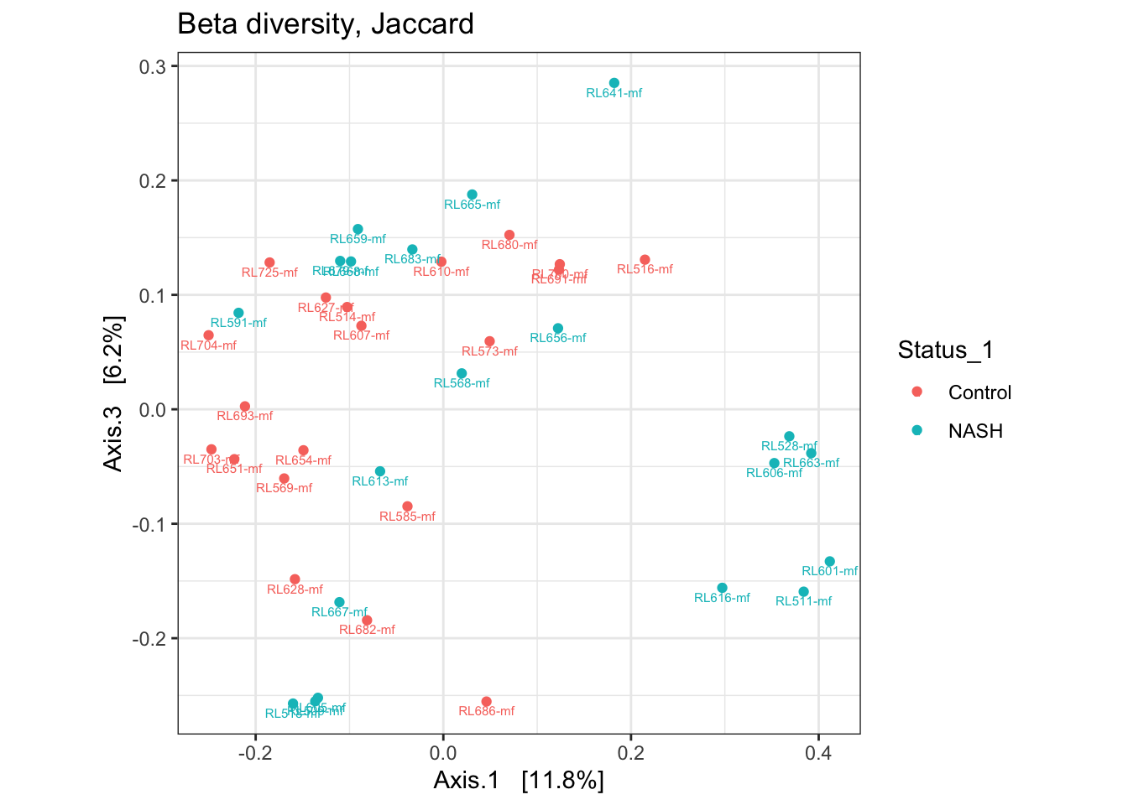
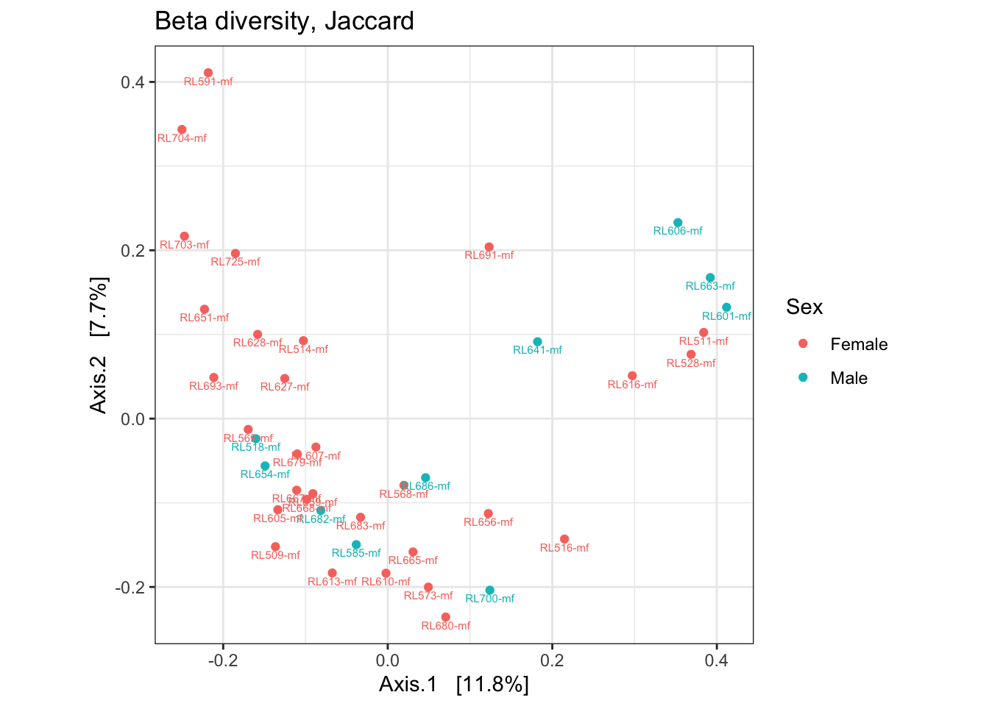
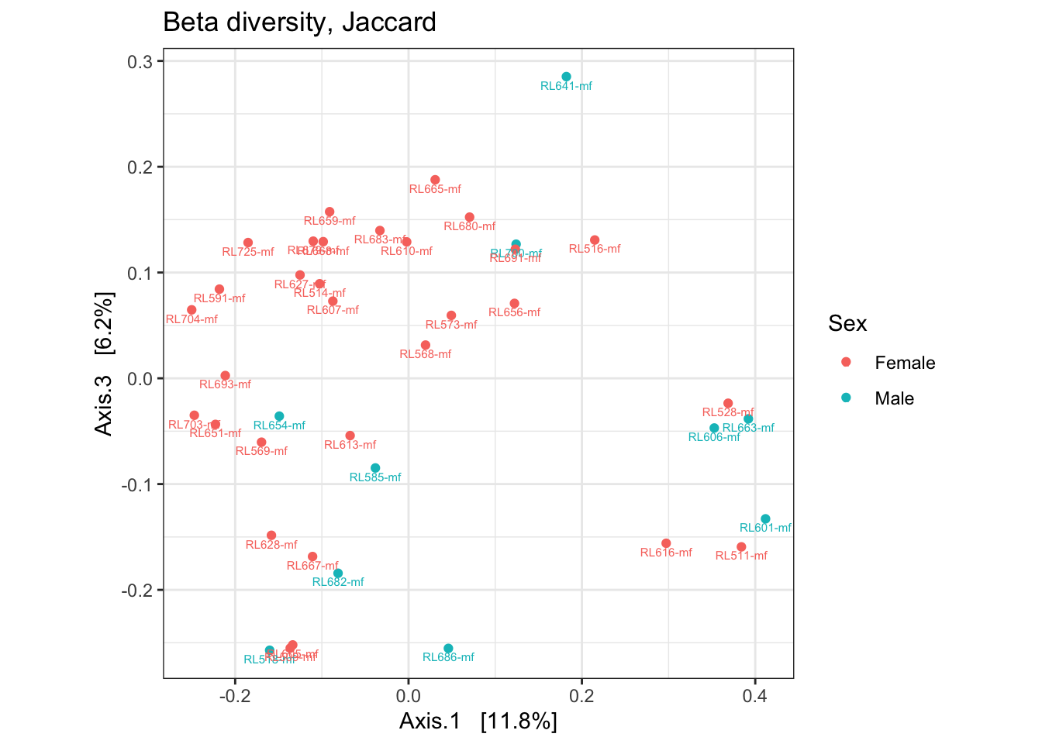
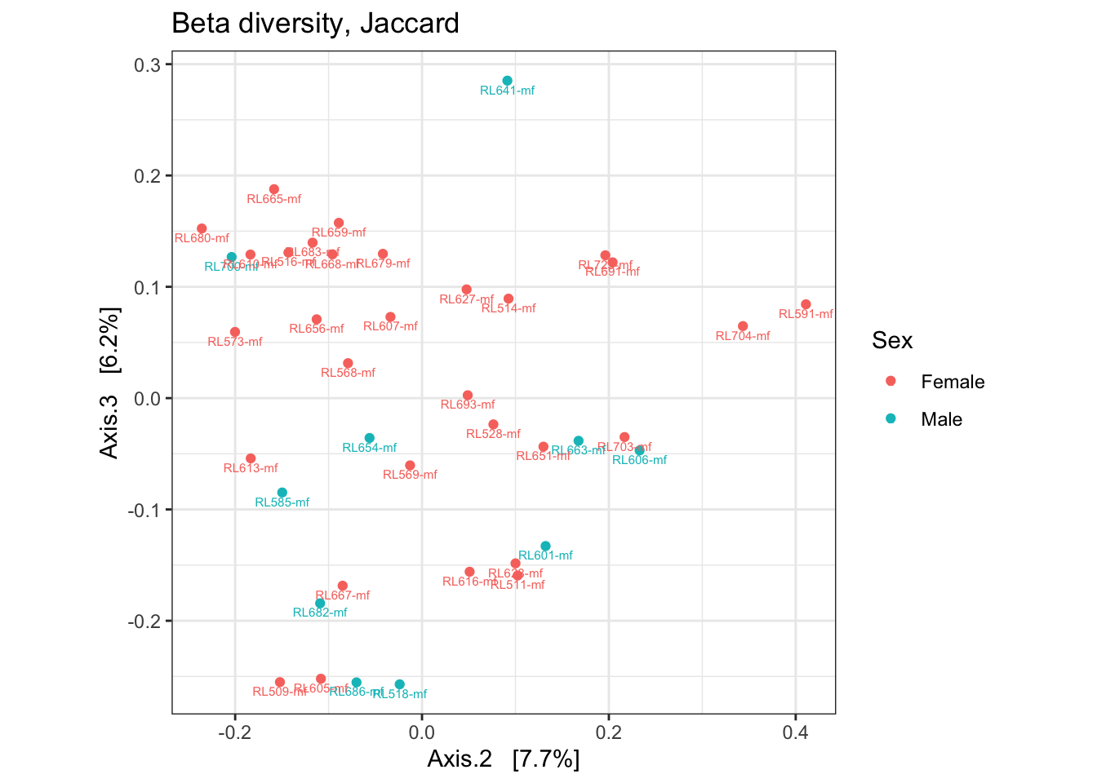
NASH vs Control considerando todas las muestras, Jaccard

Slide 11
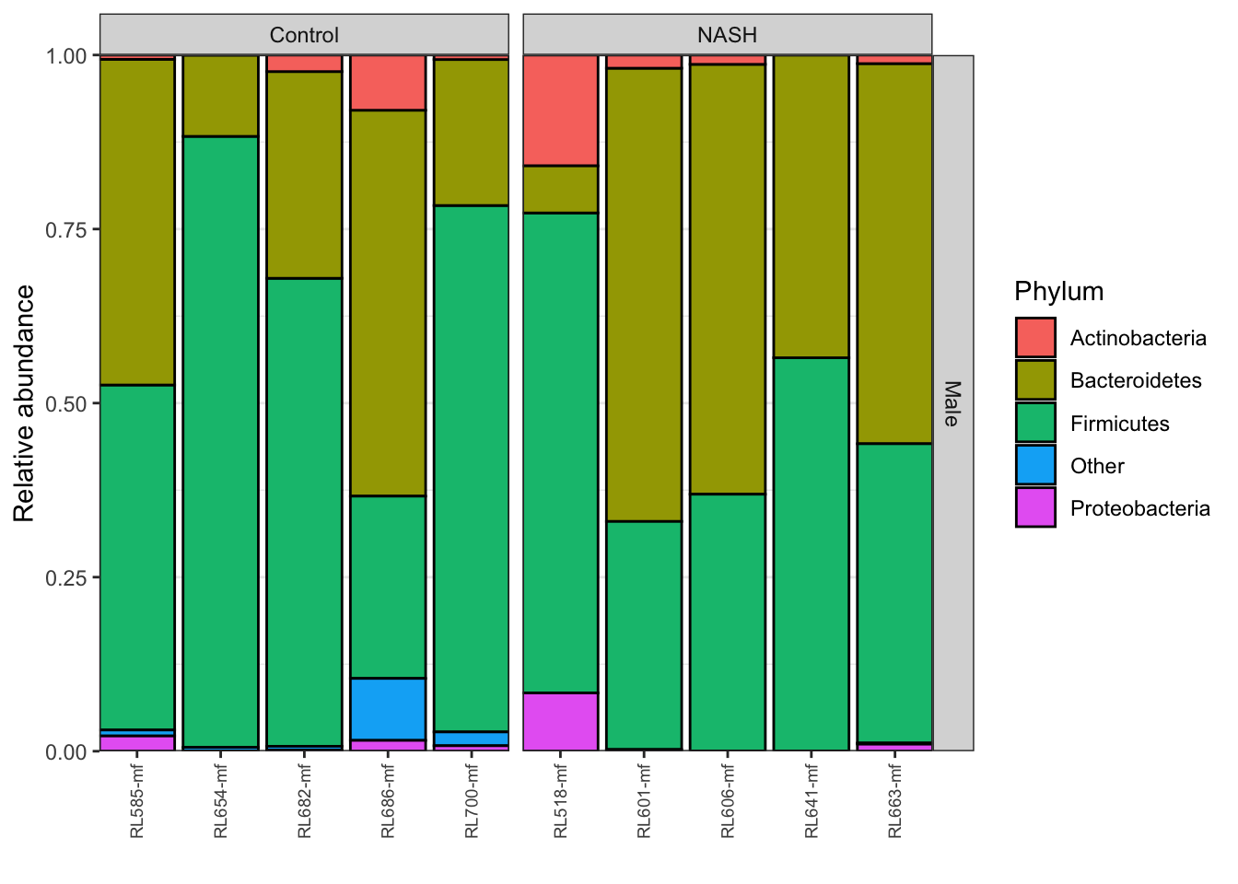
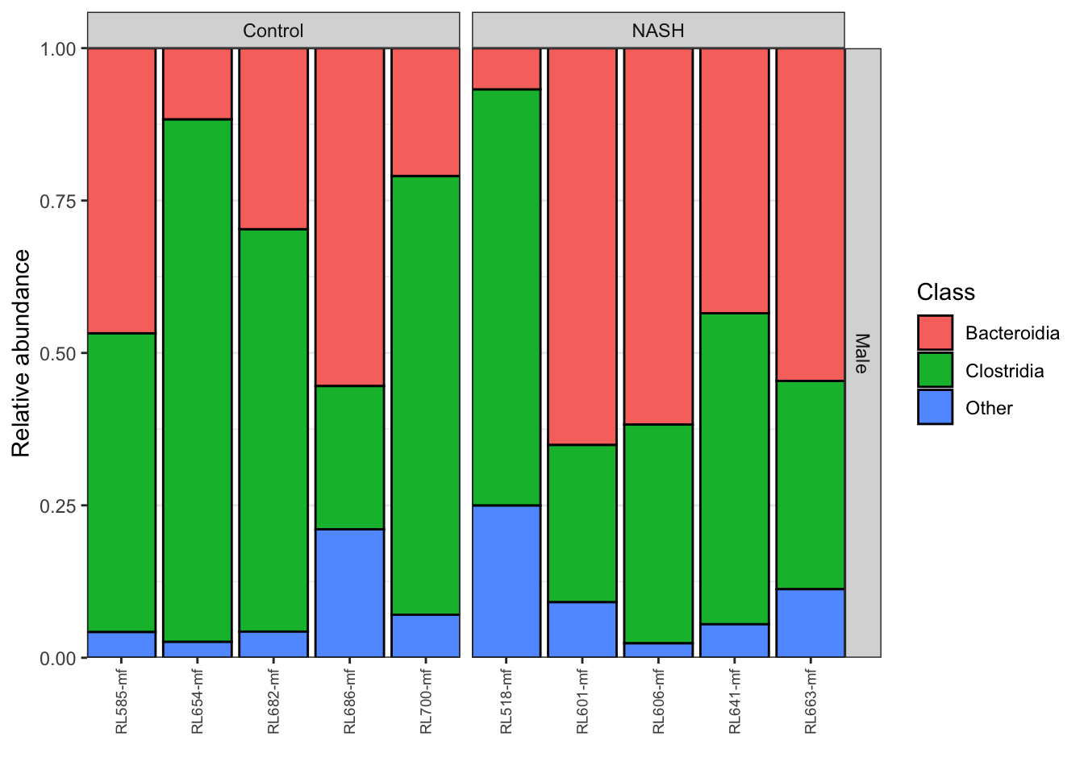
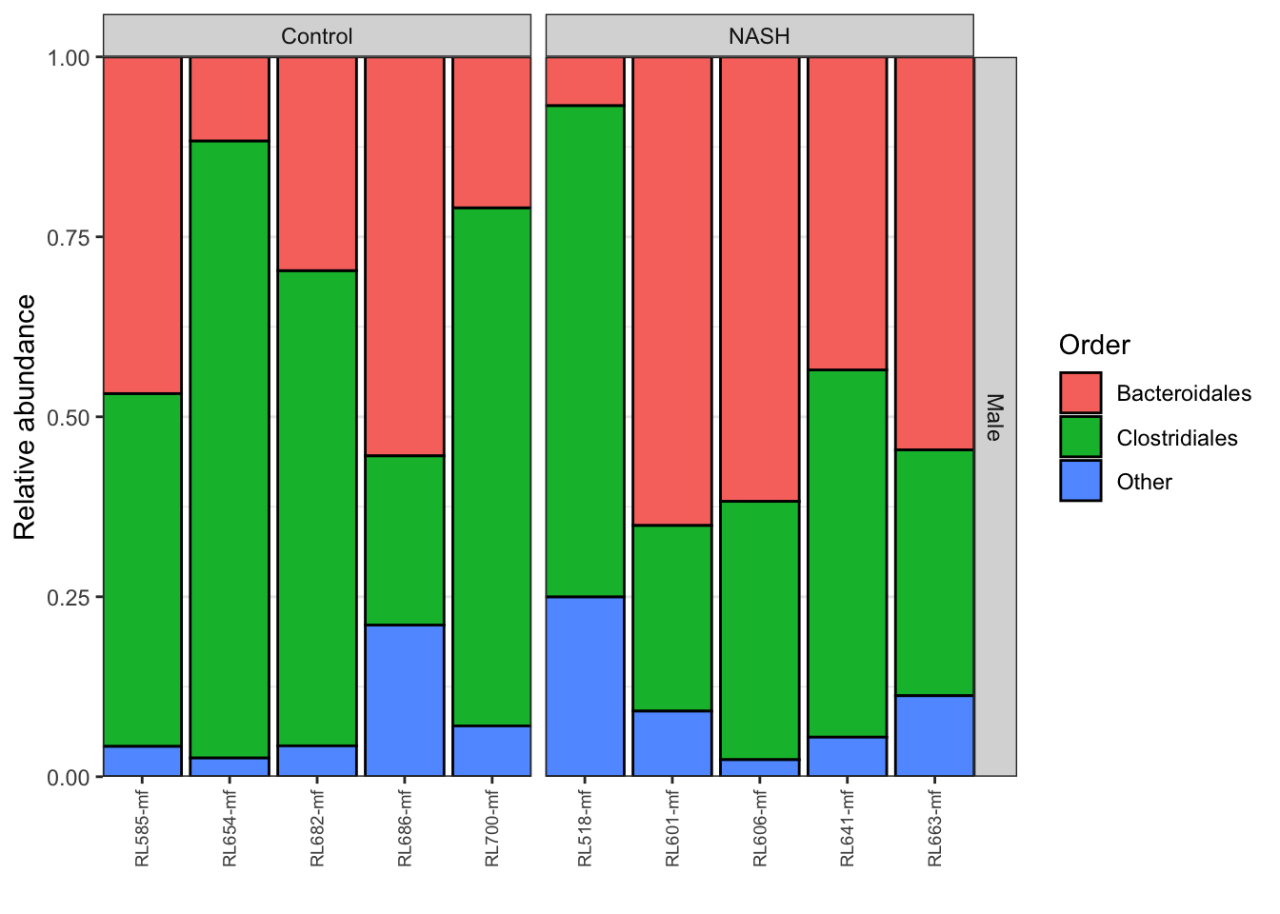
NASH vs Control estratificando por género (Male)

Slide 12
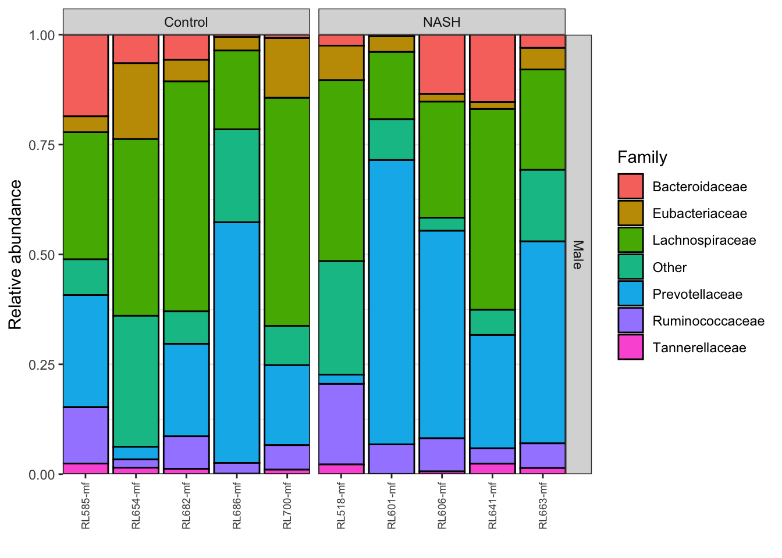
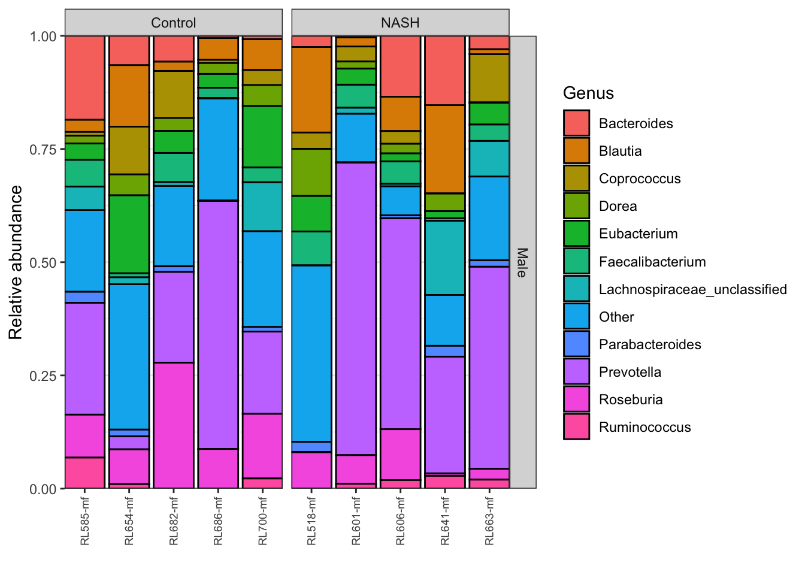
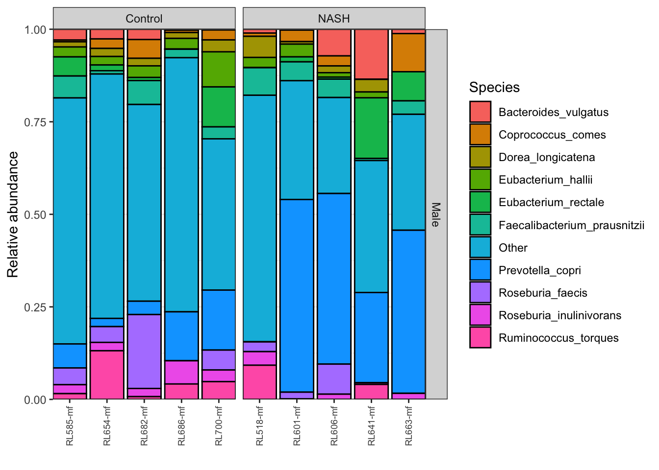
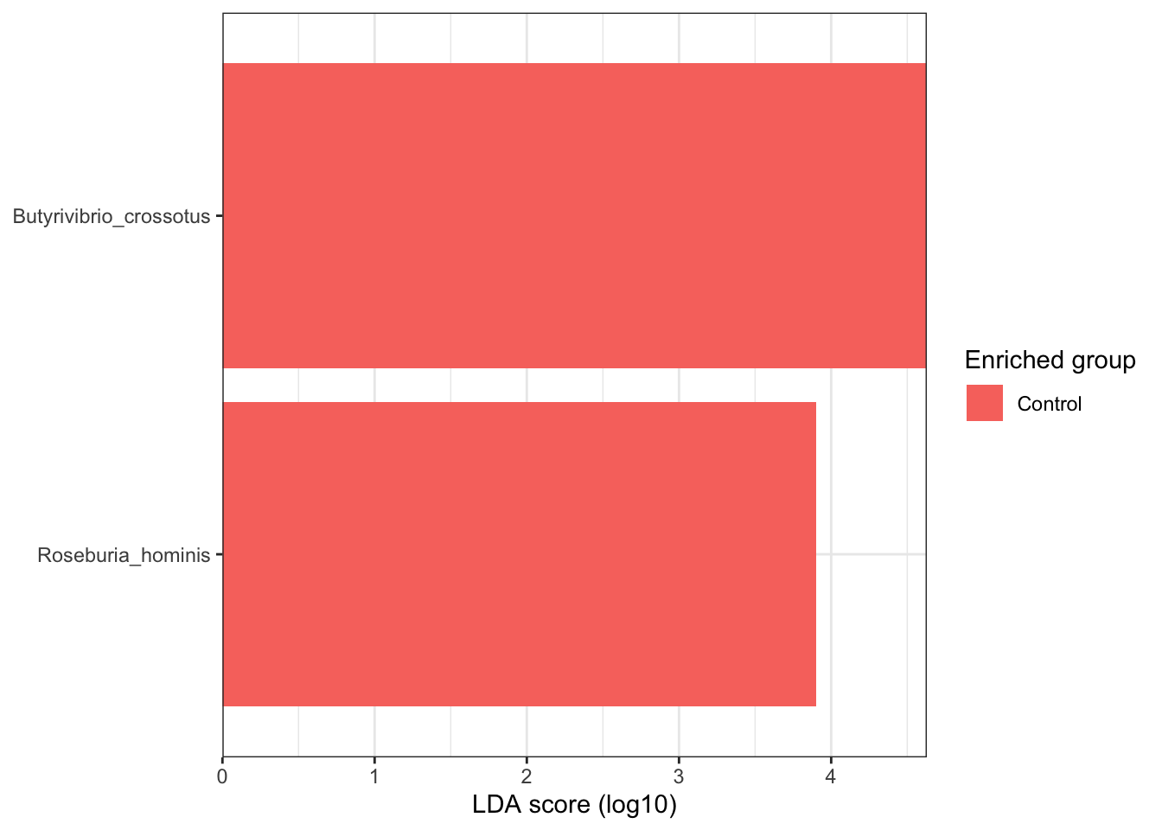
NASH vs Control estratificando por género (Male)

Slide 13
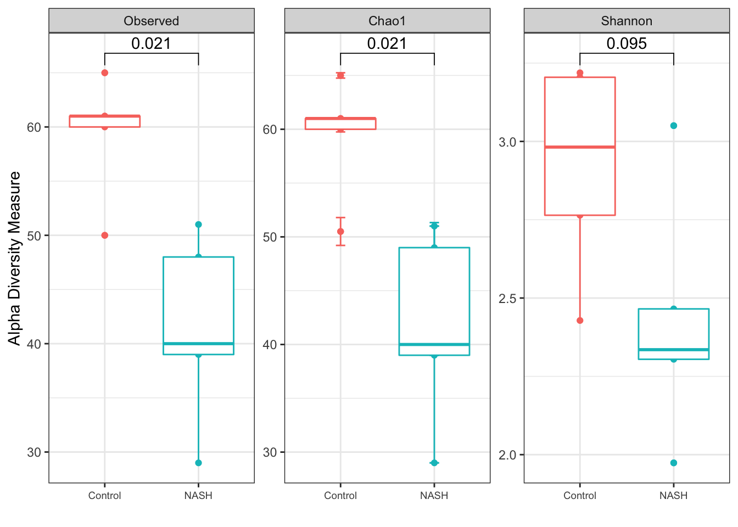
NASH vs Control estratificando por género (Male)

Slide 14
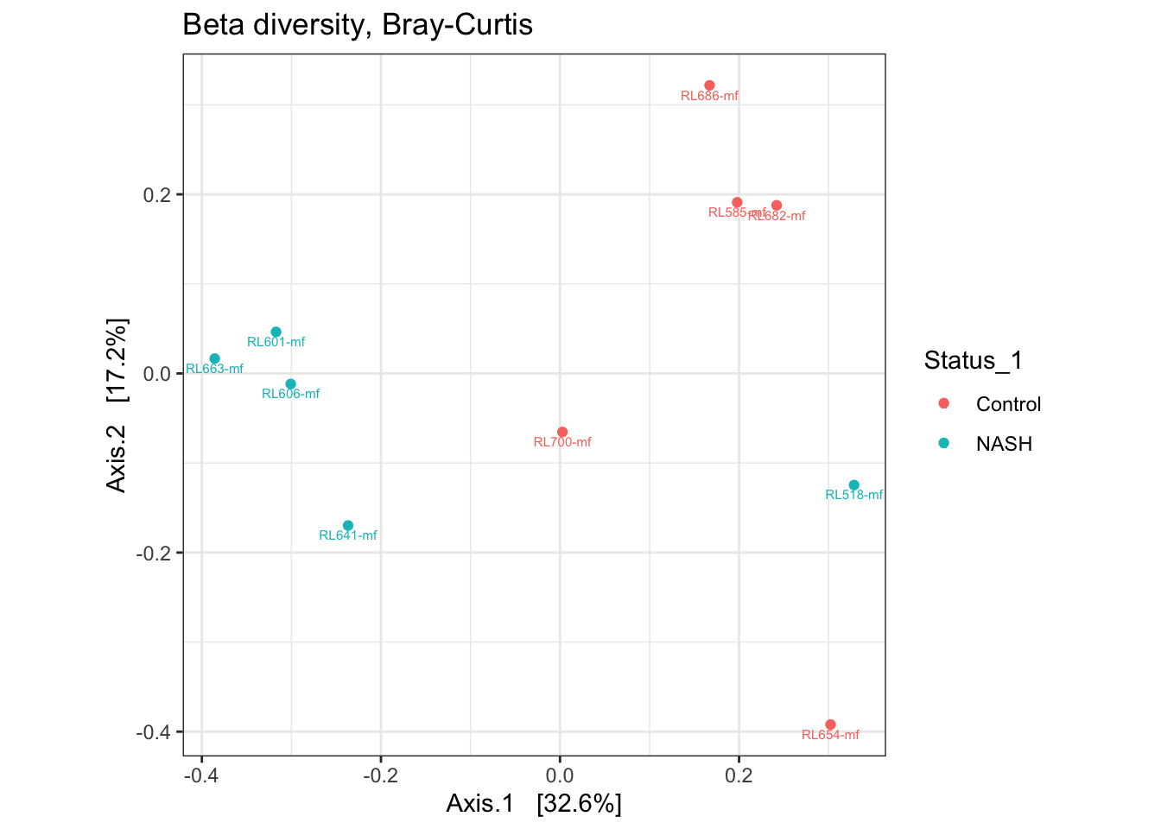
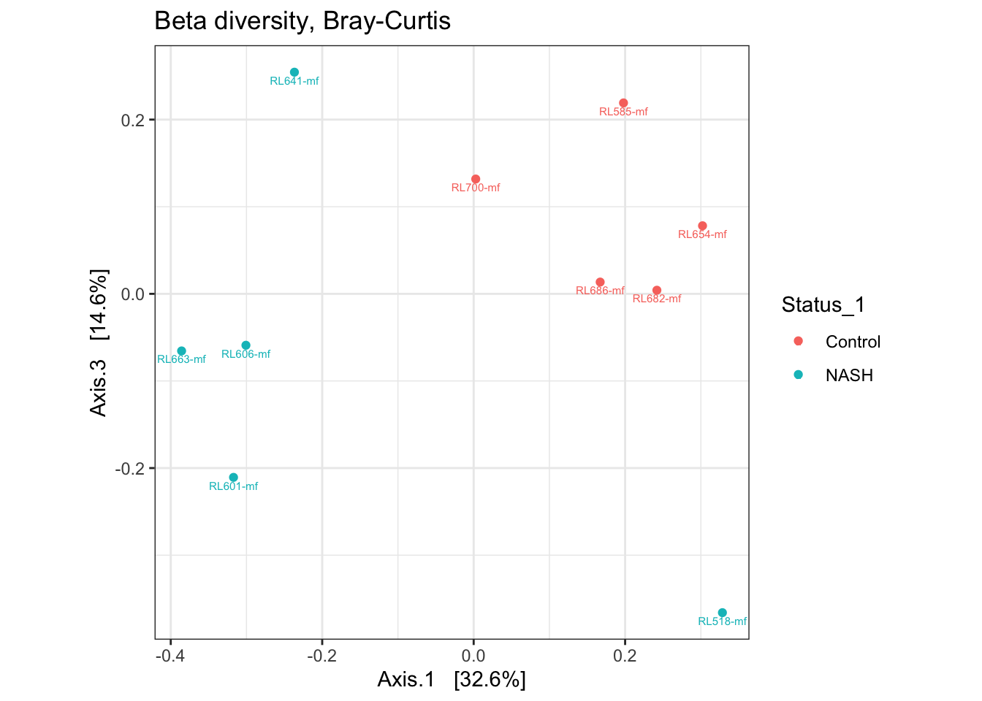
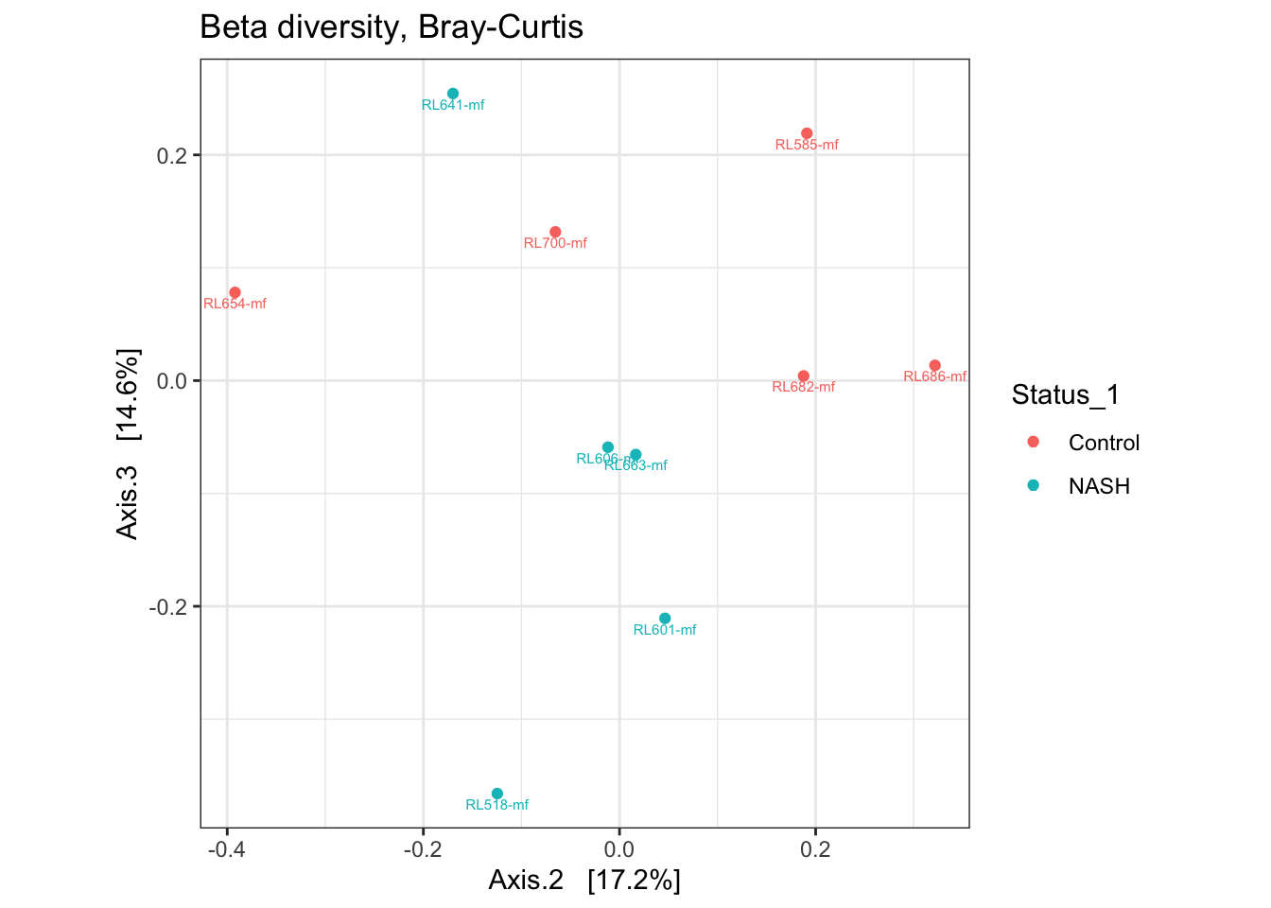
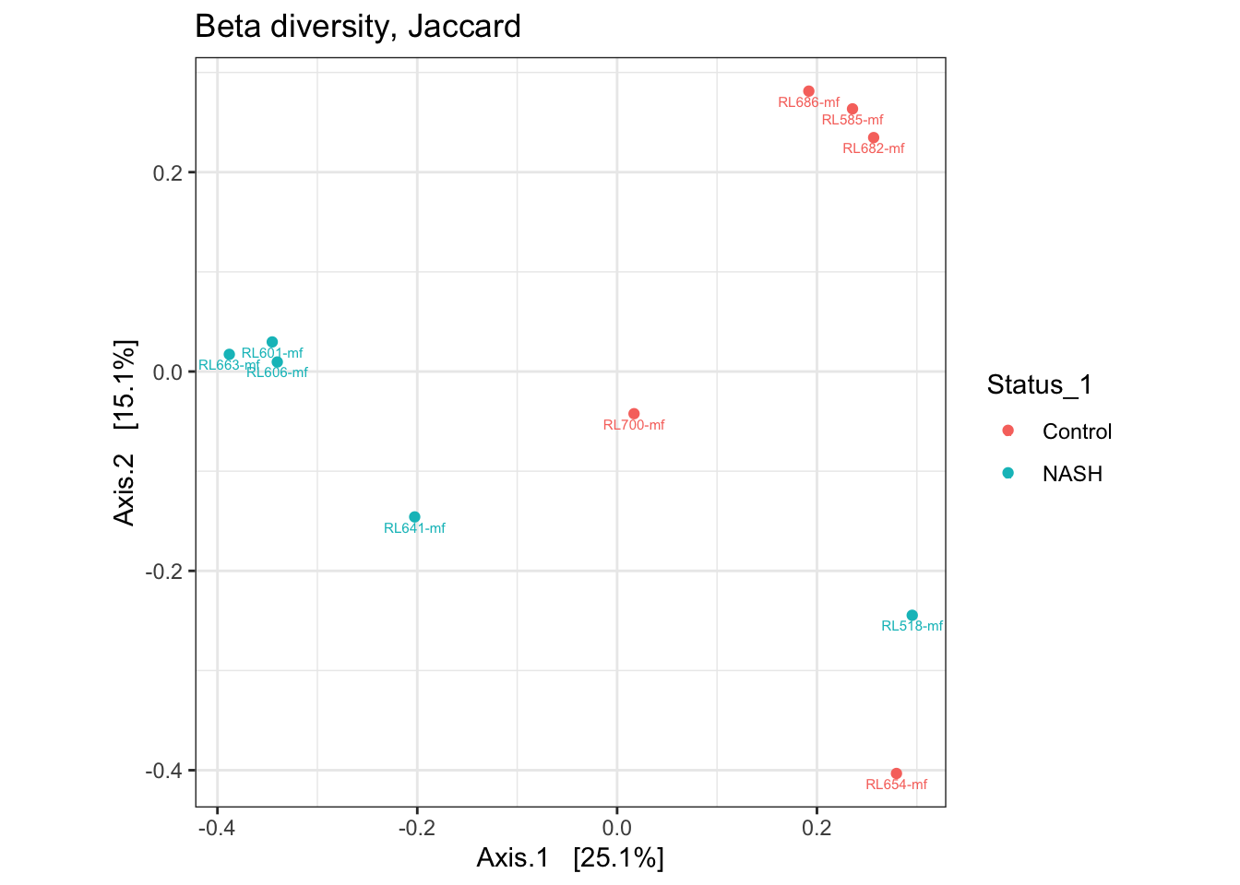
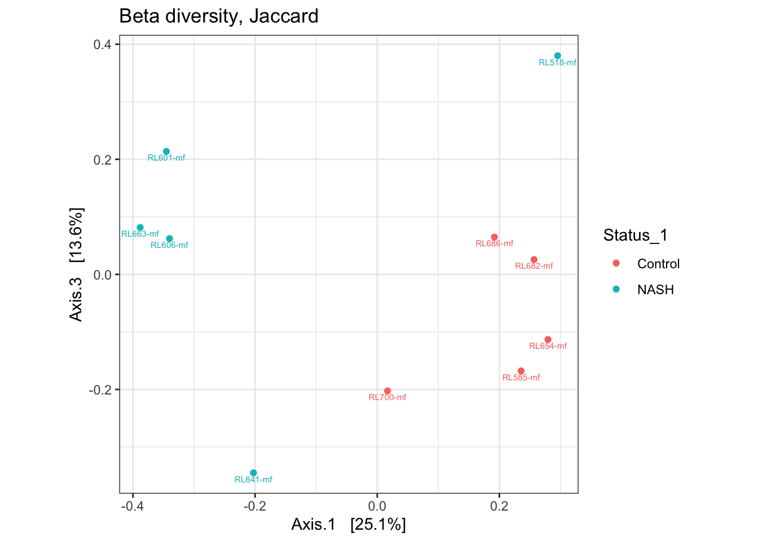
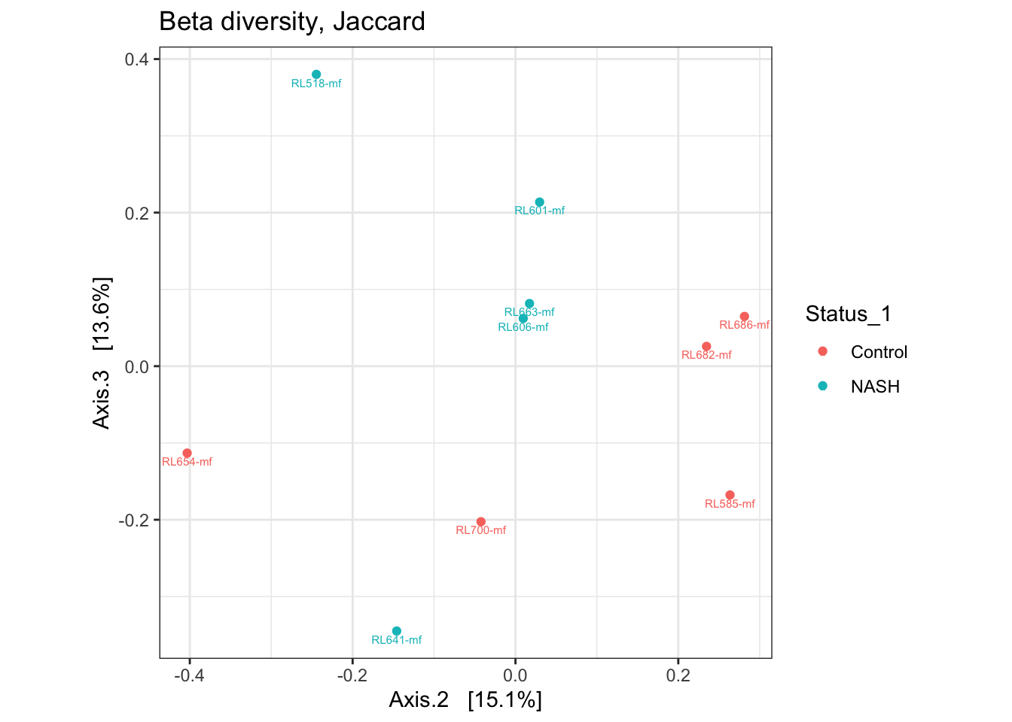
NASH vs Control estratificando por género (Male)

Slide 16
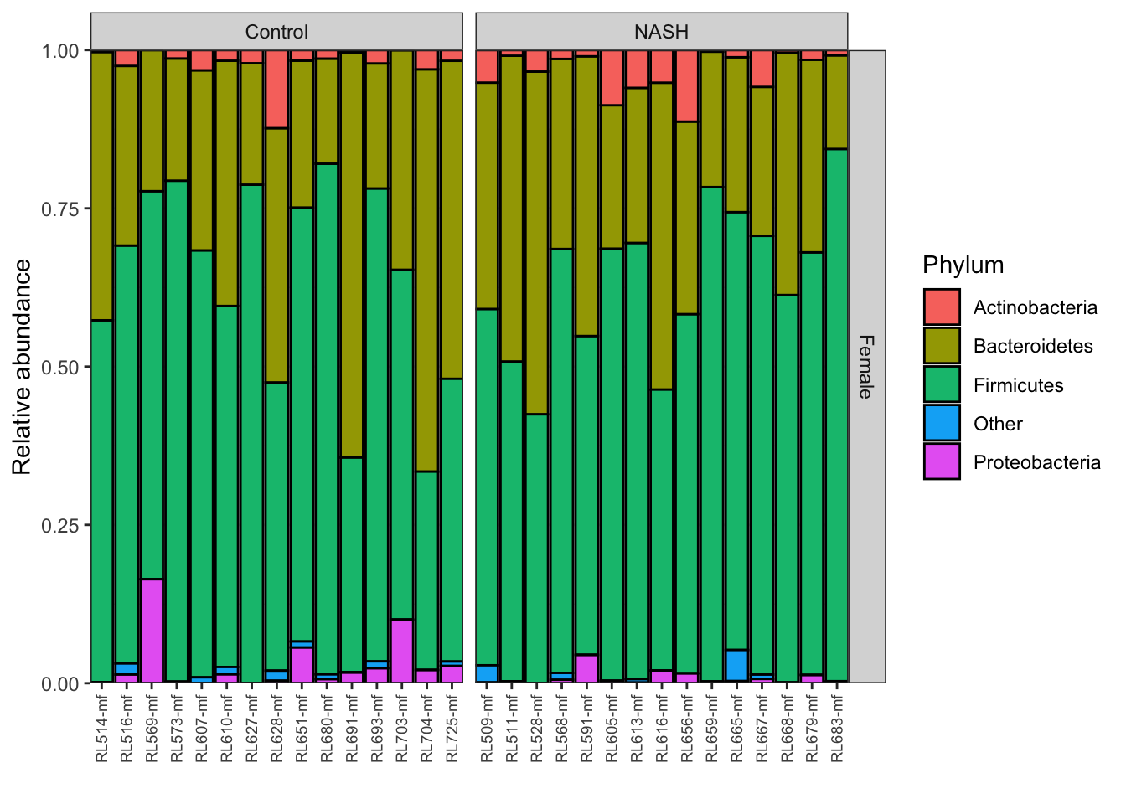

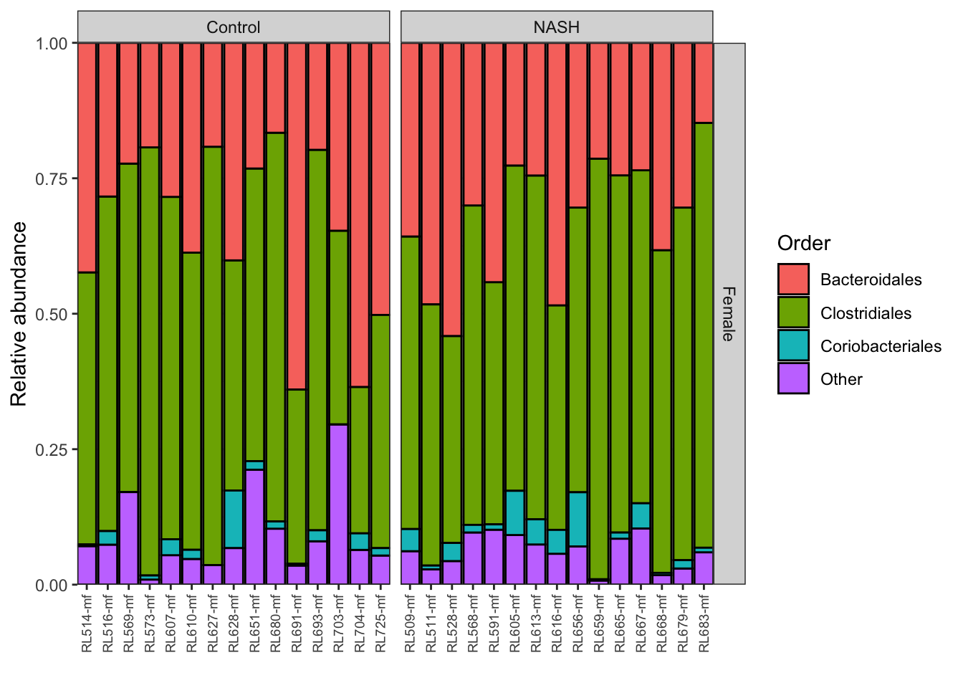
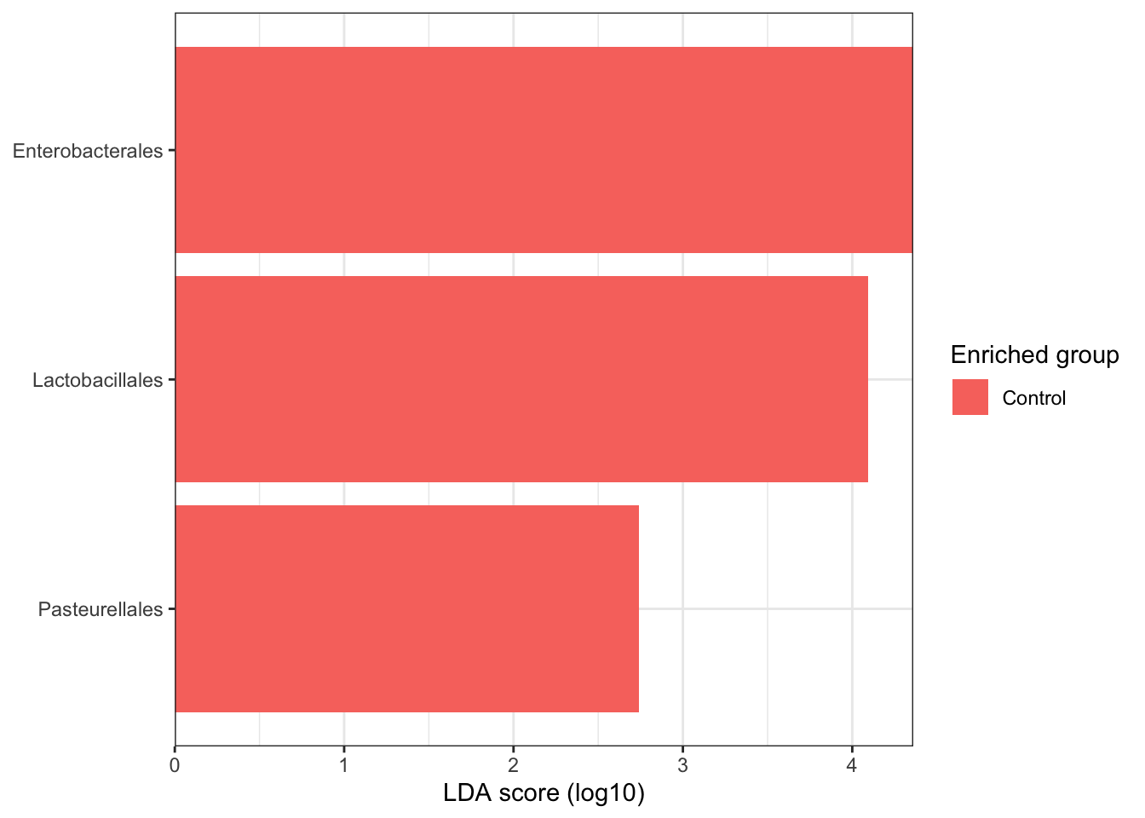
NASH vs Control estratificando por género (Female)

Slide 17
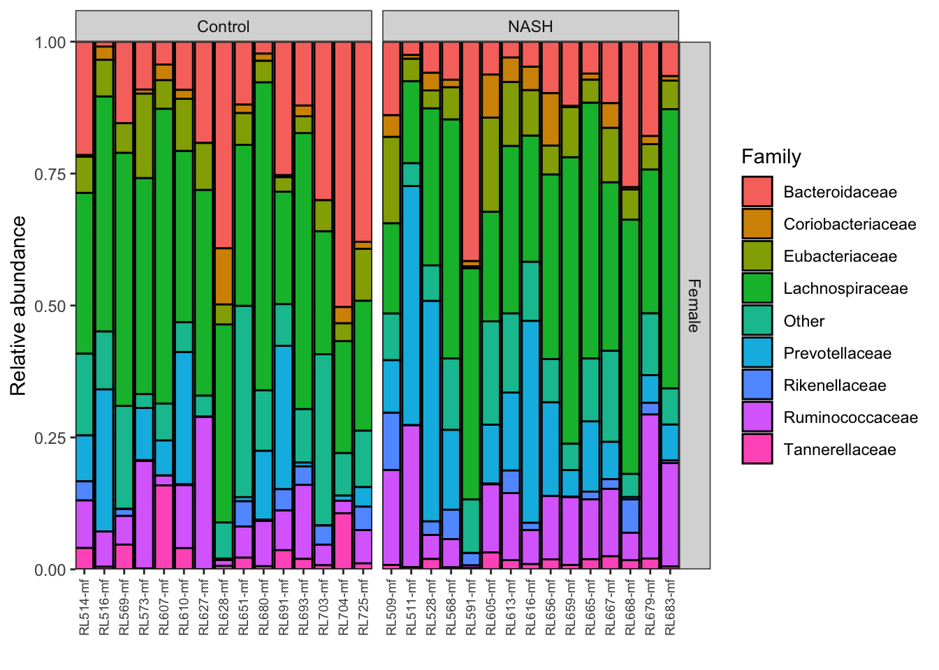
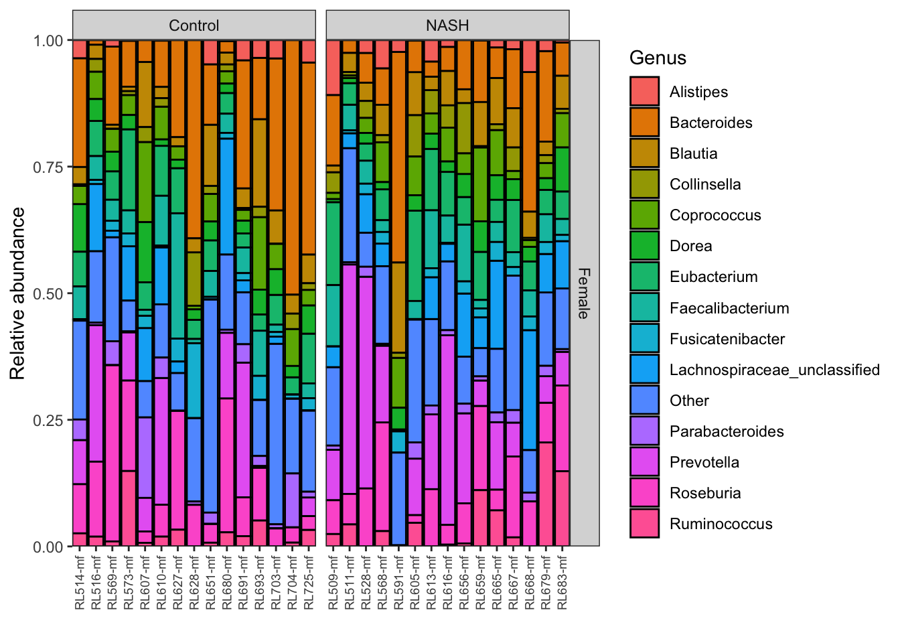
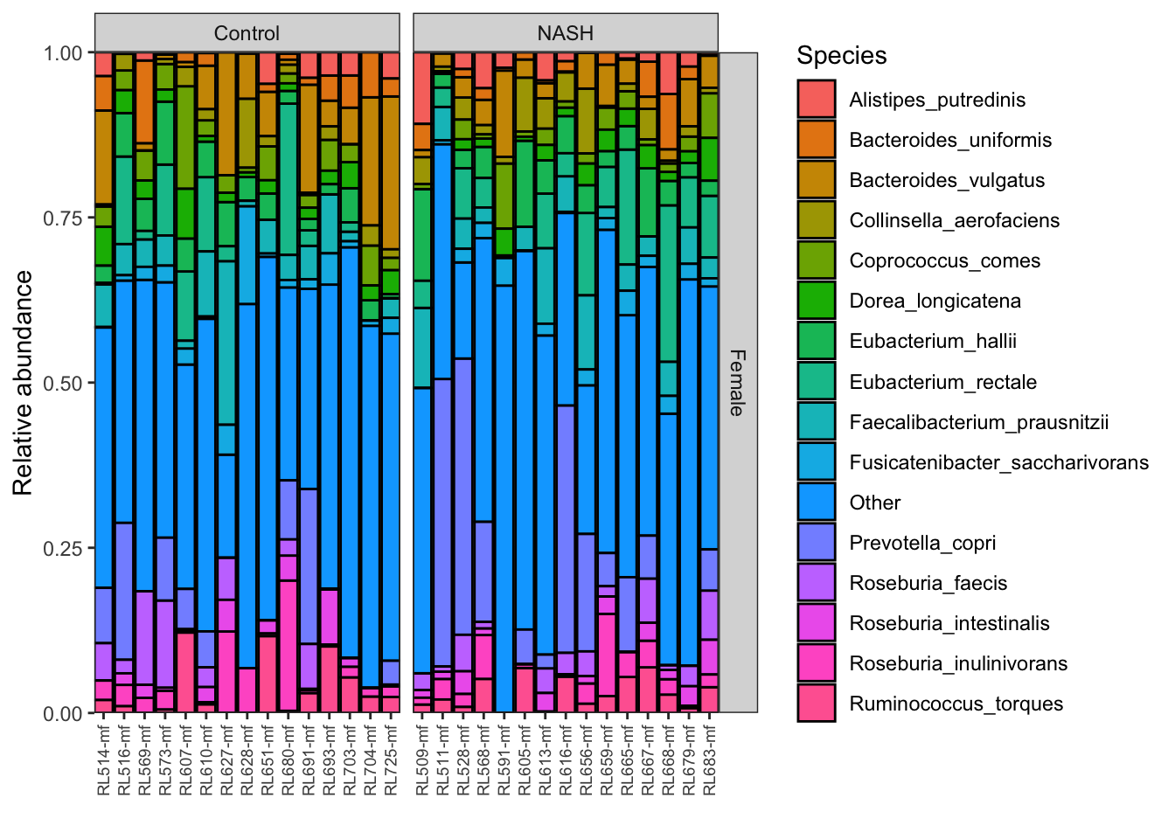
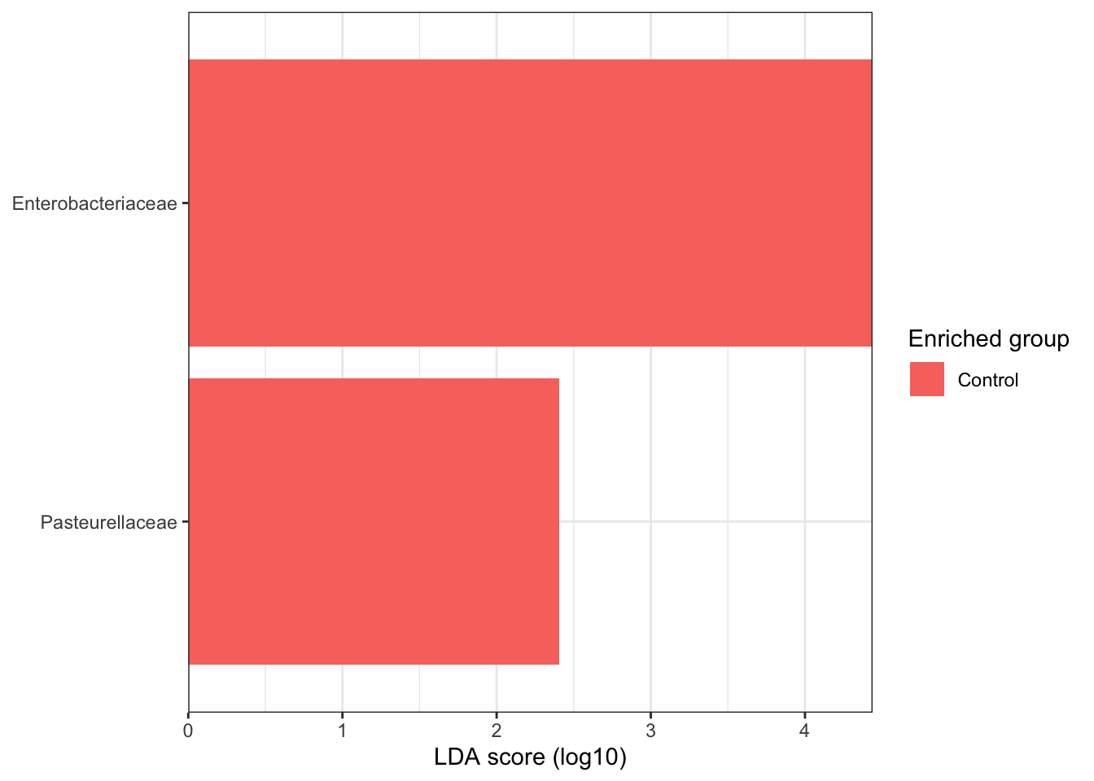
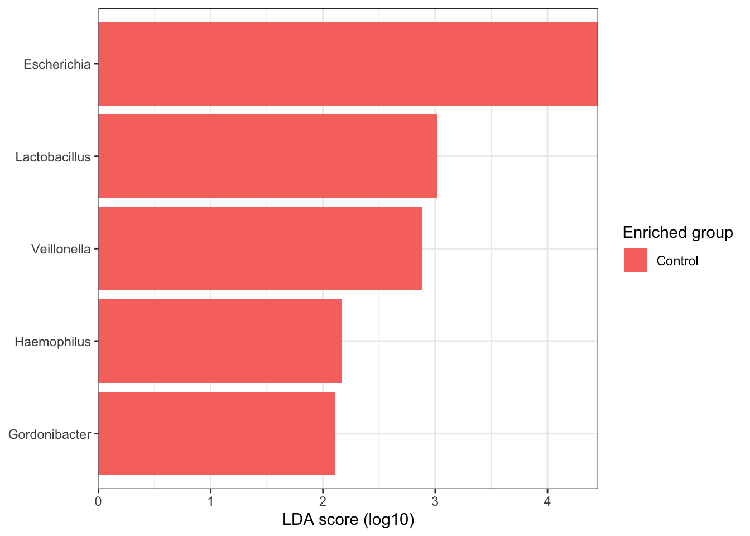
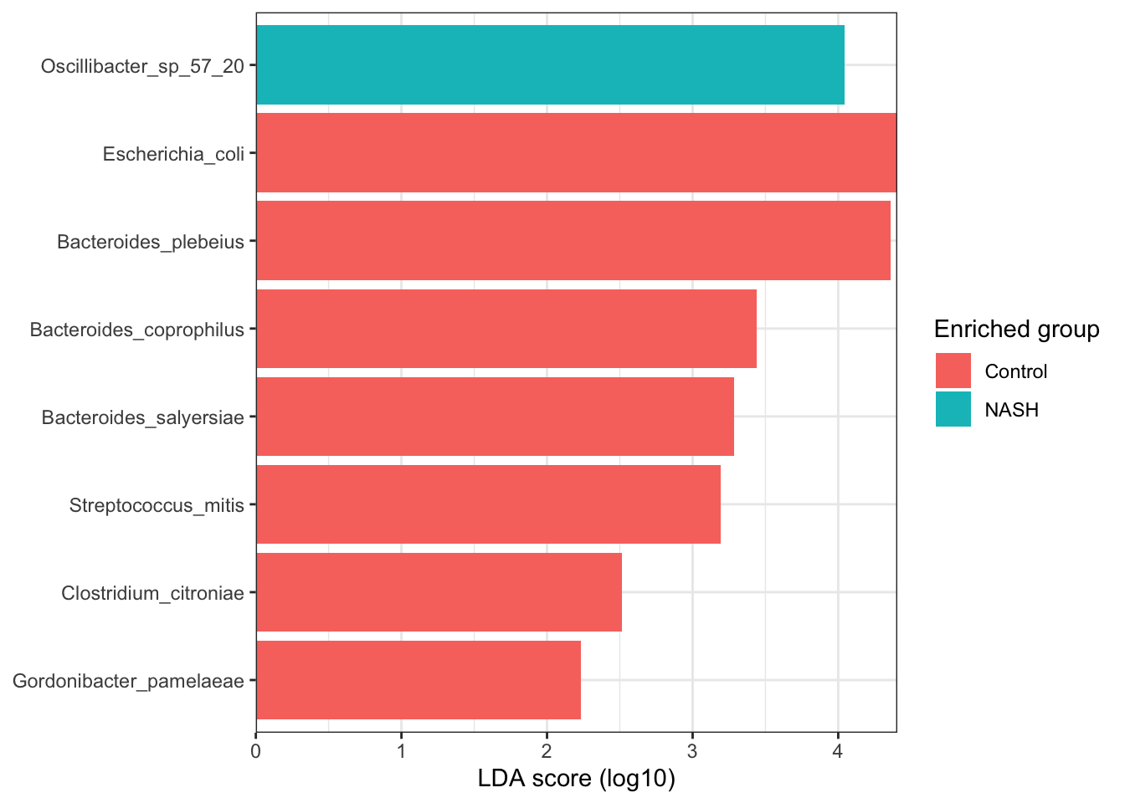
NASH vs Control estratificando por género (Female)

Slide 18
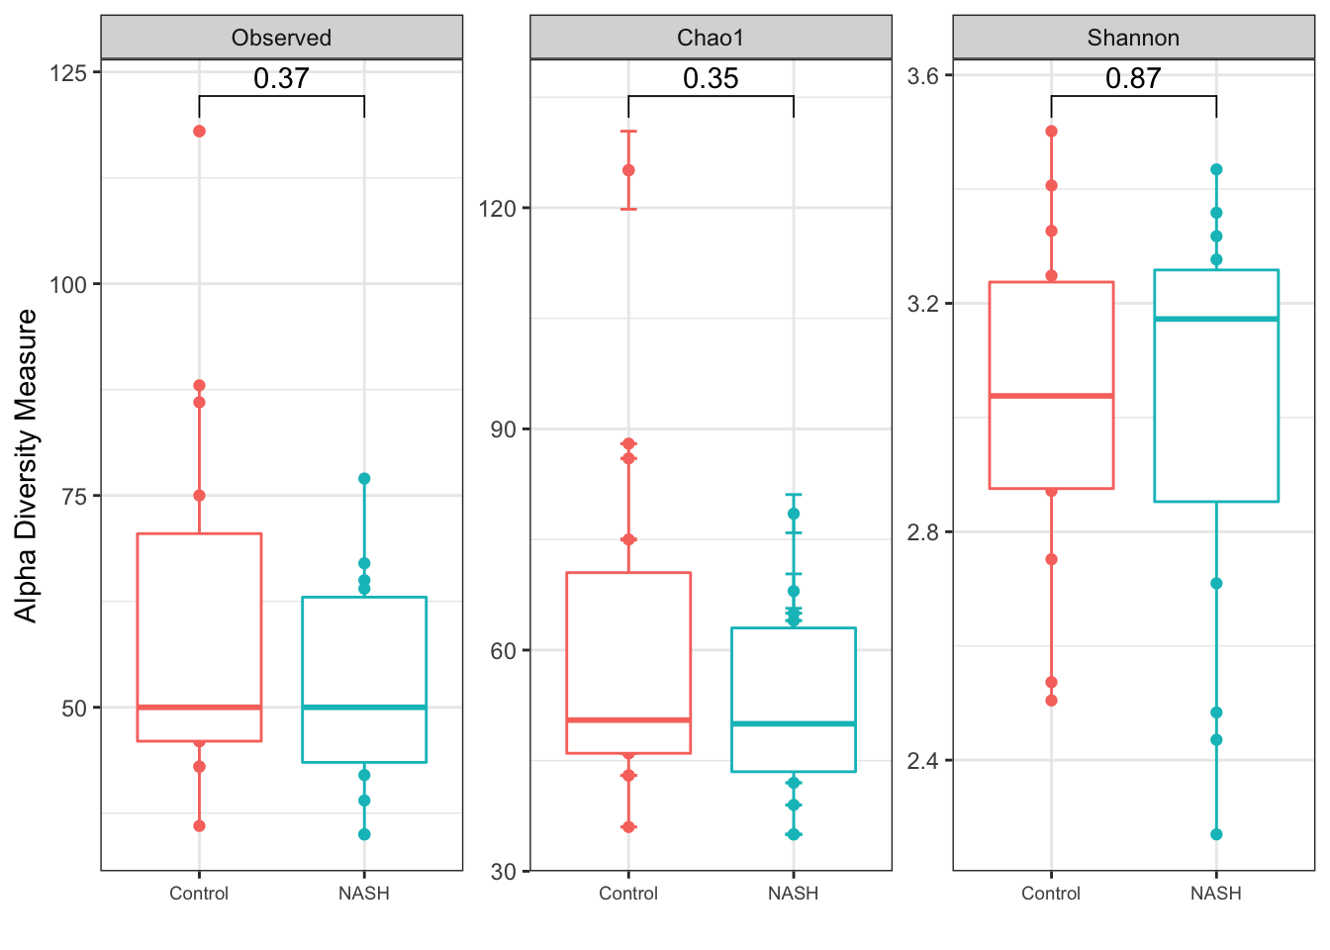
NASH vs Control estratificando por género (Female)

Slide 19
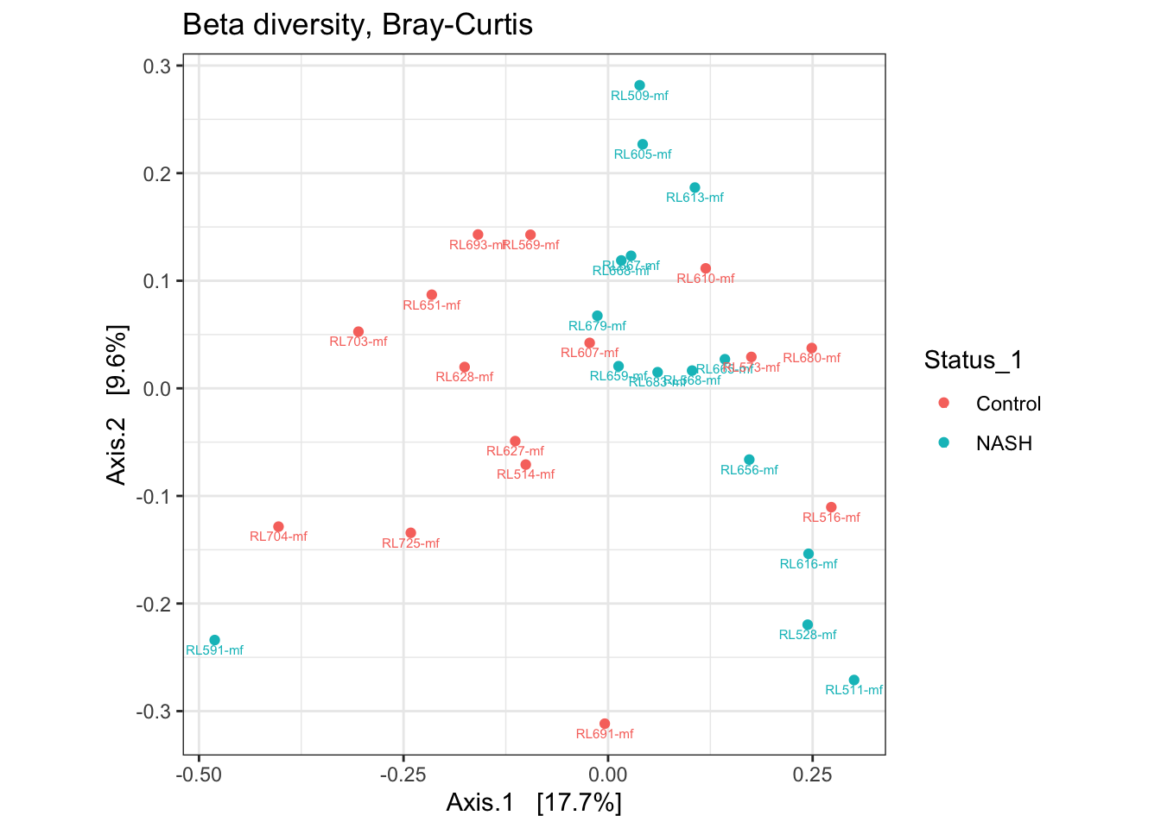
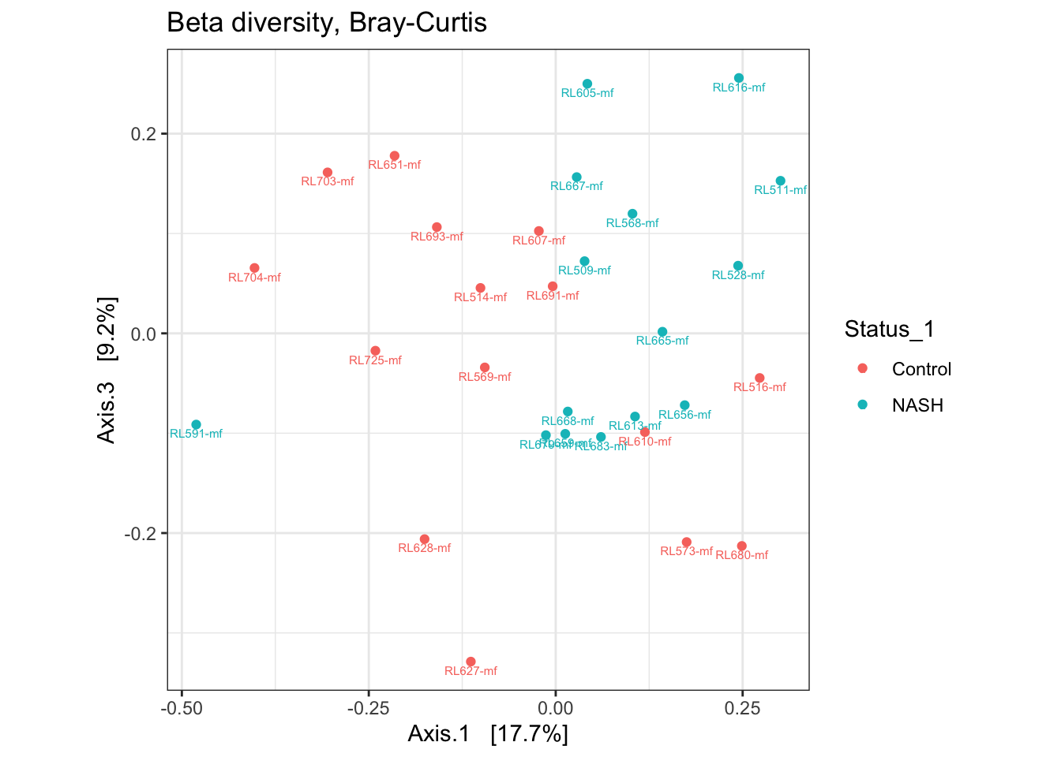
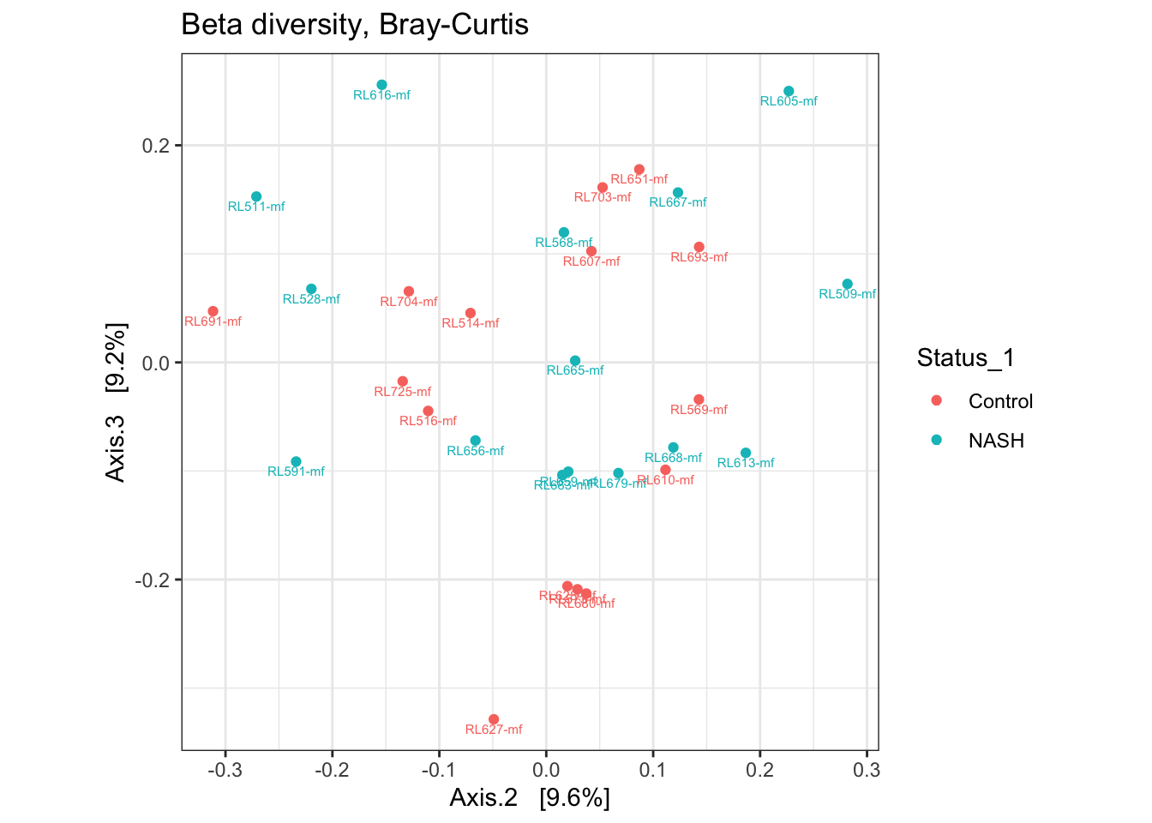
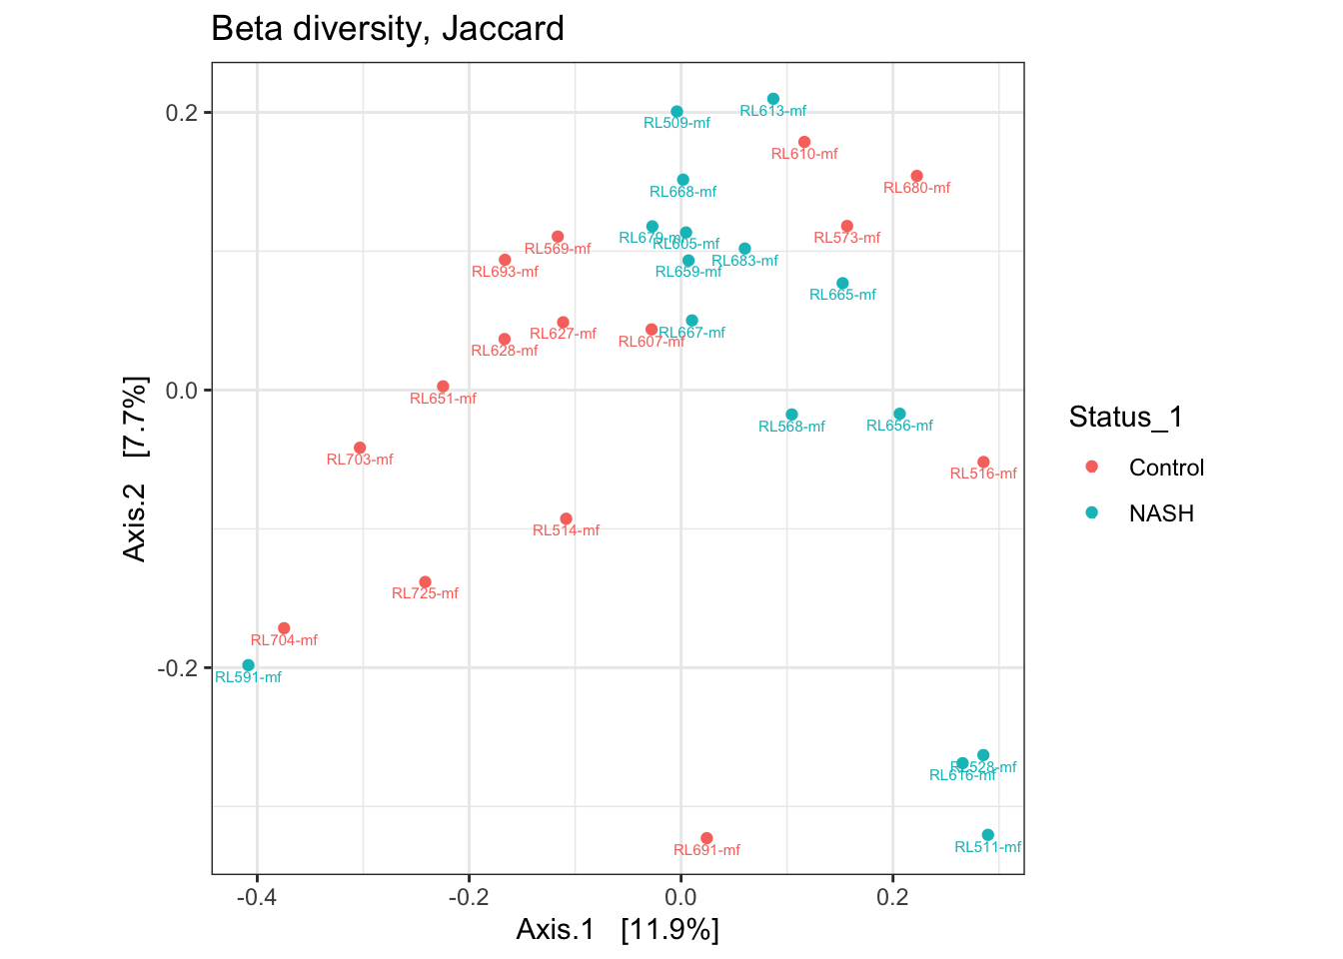


NASH vs Control estratificando por género (Female)

Slide 21
Análisis de expresión diferencial
29.06.2022

Slide 22
Comparaciones
NASH vs Control considerando todas las muestras
NASH vs Control estratificando por género (Male)
NASH vs Control estratificando por género (Female)

Slide 23

NASH vs Control considerando todas las muestras
Familias de genes

Slide 24


NASH vs Control considerando todas las muestras
Correlación entre muestras
Genes sobreexpresados

Slide 25

NASH vs Control considerando muestras femeninas
Familias de genes

Slide 26


NASH vs Control considerando femeninas
Correlación entre muestras
Genes sobreexpresados

Slide 27

NASH vs Control considerando muestras masculinas
Familias de genes

Slide 28


NASH vs Control considerando masculinas
Correlación entre muestras
Genes sobreexpresados

